Slide 1
STRATEGIES FOR MANAGING THE OCEANS
GRADE 10 GEOGRAPHY
© 2021 J.RICH

Slide 2
SOME CHALLENGING QUESTIONS
As the world’s population grows can the oceans be relied on to continue supplying enough sea food?
Is there any reason why we cannot continue to dump waste and garbage into the ocean?
Since oceans are not dry land do events and changes on land really affect what happens in the ocean?
Think about these things and give reasons for your answers

Slide 3
THE BIG PICTURE (OVERVIEW)
What problems do the world’s oceans face?
Why should we try to manage the oceans better?
How can we do that?

Slide 4
PROBLEMS FACING THE OCEANS
Pollution
Acidification
Overfishing
Global warming

Slide 5
OCEAN POLLUTION

Slide 6
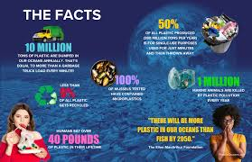

Slide 7
OCEAN POLLUTION - SOURCES
Dumping
Land run-off
Oil spills
Littering
Ocean mining
Noise pollution

Slide 8
HOW OCEAN WASTE HAS CHANGED
150 years ago
Today
Metals – Ferrous, bronze, copper (corroded quickly), lead (toxic but limited) , silver and gold (non-reactive)
Vegetable matter, wood, paper – biodegradable
Glass and ceramics – crushed and absorbed
Population < 2 billion
Most shipping was wind or coal powered – minimal fuel dumping
Metals – highly toxic mercury, cadmium, lithium etc.; radioactive materials
Plastics – indestructible and non degradable
Chemicals and fertilizers
Population around 8 billion
Shipping uses and spills or dumps petrochemicals and oil

Slide 9
OCEAN POLLUTION -EFFECTS
Kills marine life
Harms human health
Damages tourist sites
Accumulates

Slide 10
ACIDIFICATION
When fossil fuels such as coal, diesel or petrol burn they release carbon and sulphur into the air.
This combines with rain water and produces dilute acids
The acid balance of the oceans has changed drastically in the last 40 years
This kills off many marine species

Slide 11
OVERFISHING
Sea life is only a renewable resource if it has the time and conditions to renew itself.
Sea life that is extinct or severely depleted is not renewable.
Currently about 75% of the ocean’s marine life is under severe threat.
Commercial fishing is often very wasteful – bycatch is often left to die

Slide 12
GLOBAL WARMING
Climate change and global warming from factors such as greenhouse gases can change sea temperatures.
This can affect the growth of marine life and even kill off species
It also leads to melting of polar ice and changes in sea level and coastlines

Slide 13
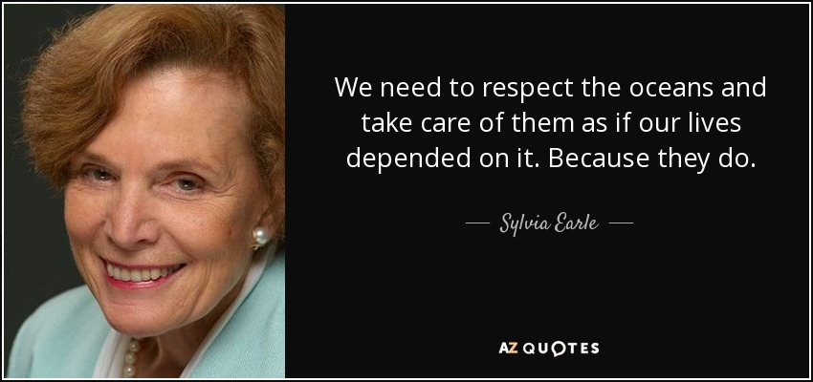

Slide 14
HOW TO CARE FOR THE OCEANS
International agreements – to take responsibility for coastal waters
Develop protective laws for international waters
Aquaculture
Catch limits and quotas
Wider net mesh
No fishing zones
Prevent destructive substances entering the sea
Ban single use plastics

Slide 15
EVERYBODY’S ISSUE
What are two things you can do in your daily life that can help to reduce pressure on the oceans?

