Slide 1
WATER IN THE WORLD
GRADE 10 GEOGRAPHY
© 2021 J.RICH

Slide 2
THE BIG PICTURE
Life on earth is heavily dependent on water.
Although most of the earth is covered in water much is of limited use.
Where is the water, where does it come from and how can we use it best?

Slide 3
OVERVIEW
Different states of water on earth
Hydrological cycle
Occurrence of salt and fresh water

Slide 4
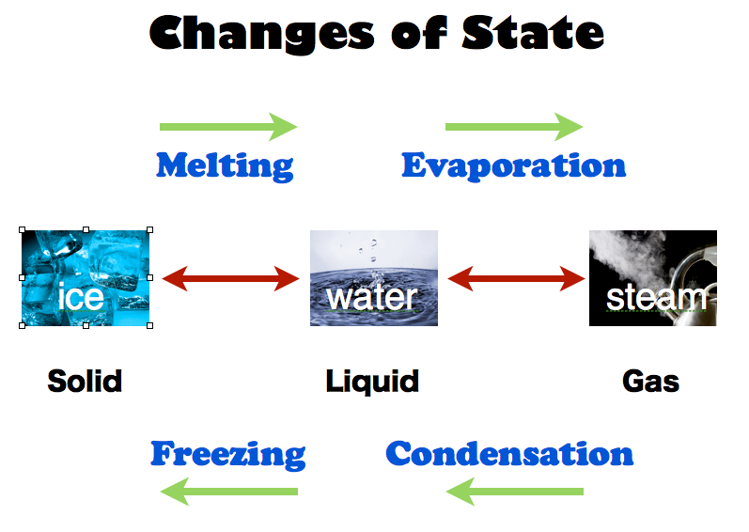
DIFFERENT STATES OF WATER

Slide 5
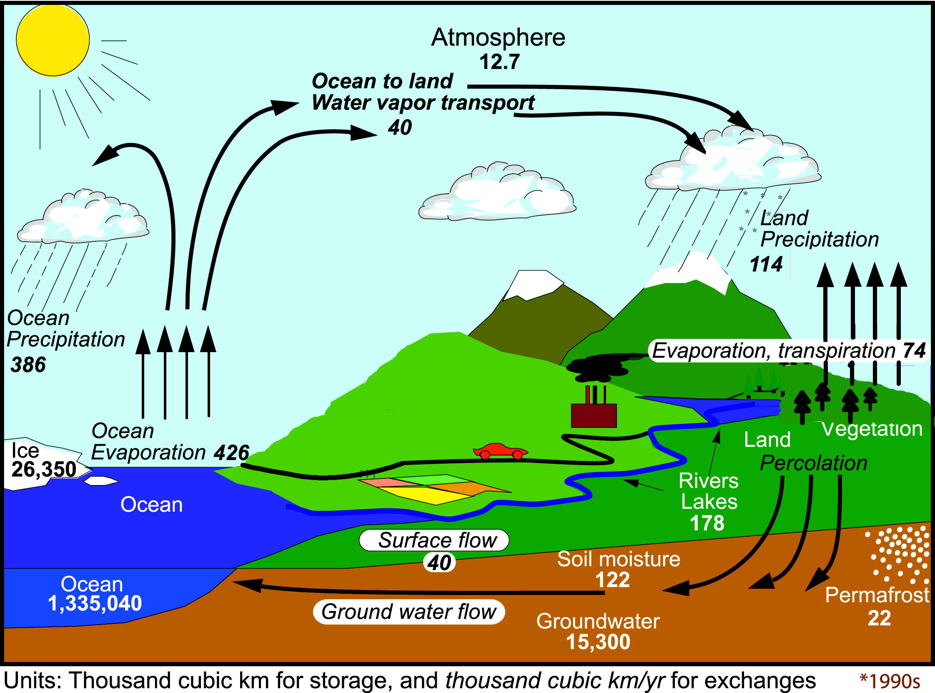
HYDROLOGICAL CYCLE

Slide 6
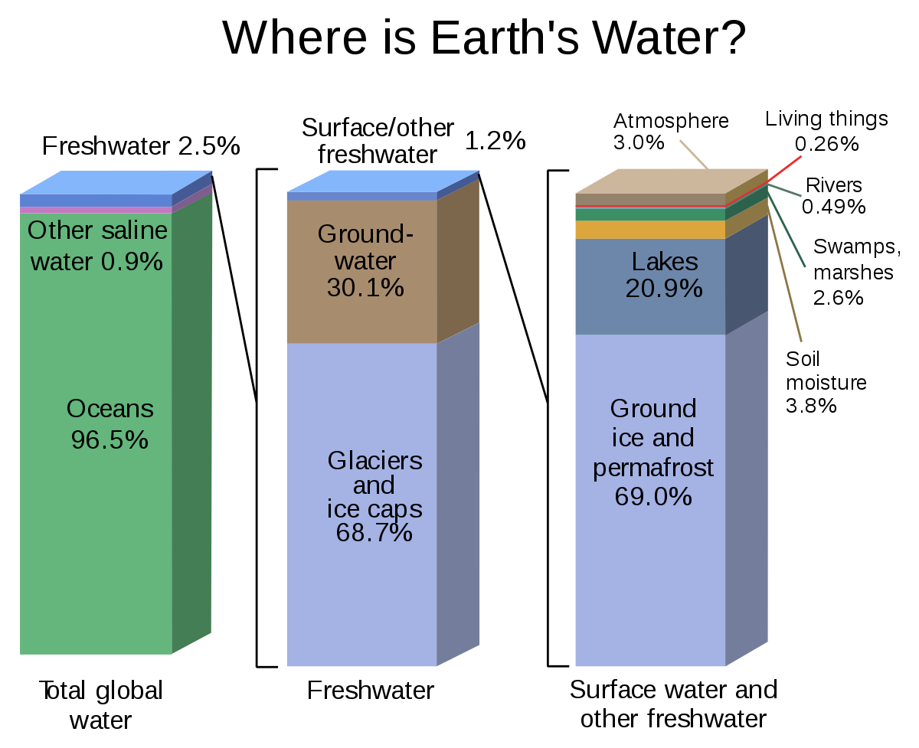
OCCURRENCE OF SALT AND FRESH WATER

Slide 7
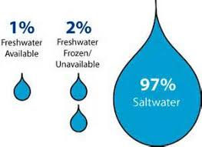
HOW MUCH WATER IS AVAILABLE?

