Slide 1
THE IMPORTANCE OF OCEANS
GRADE 10 GEOGRAPHY
© 2021 J.RICH

Slide 2
THE BIG PICTURE
Do we really need the oceans if we live on land?
How do we benefit from oceans?
How can we manage the way we use the oceans/

Slide 3
OVERVIEW
Oceans as a source of oxygen
Oceans as a source of food
Oceans as a source of energy

Slide 4
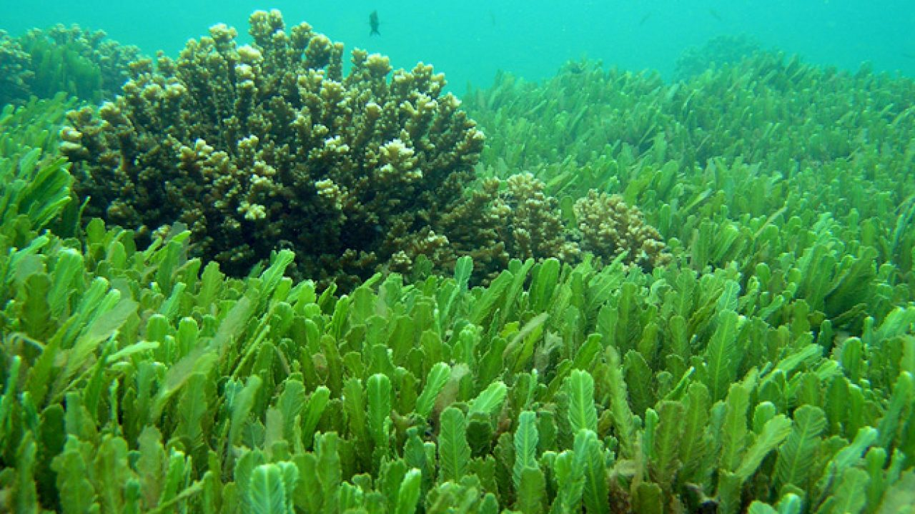
OCEANS PROVIDE OXYGEN
Algae – use carbon dioxide in the water and the atmosphere and convert it through photosynthesis to produce oxygen.
More than 7000 species of algae and most live in oceans.
Algae produce nearly 1 billion tons of oxygen per day

Slide 5
OCEANS PROVIDE FOOD
Micro-organisms (plankton) feed smaller fish species who in turn feed larger species who are the food source of apex predators. Humans harvest both large and small species and fish and shellfish.
South Africa’s annual fish catch is about 650 000 tons and the fishing industry employs around 22000 people
Most fishing in South Africa is along the west coast where he colder water produces richer nutrient supplies.
South Africa also has a long coastal shelf providing fairly shallow water allowing for a greater variety of available fish

Slide 6
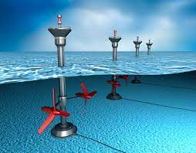
OCEANS PROVIDE ENERGY - ELECTRICITY
Sea water is constantly moving: waves and tides
The energy of moving water can be converted by means of turbines to generate electricity.
Tidal energy is more consistent and predictable than wind energy and it produces no pollution

Slide 7
TIDAL ENERGY – PROS AND CONS
ADVANTAGES
DISADVANTAGES
Cheap to run
Does not pollute / clean
Unlike wind turbines do not disturb animal life
Predictable and consistent
Can supplement the grid
Made from non-recyclable materials that are difficult to dispose
Can become less efficient as marine life turn them into artificial reefs
Can interfere with shipping
Expensive to set up

Slide 8
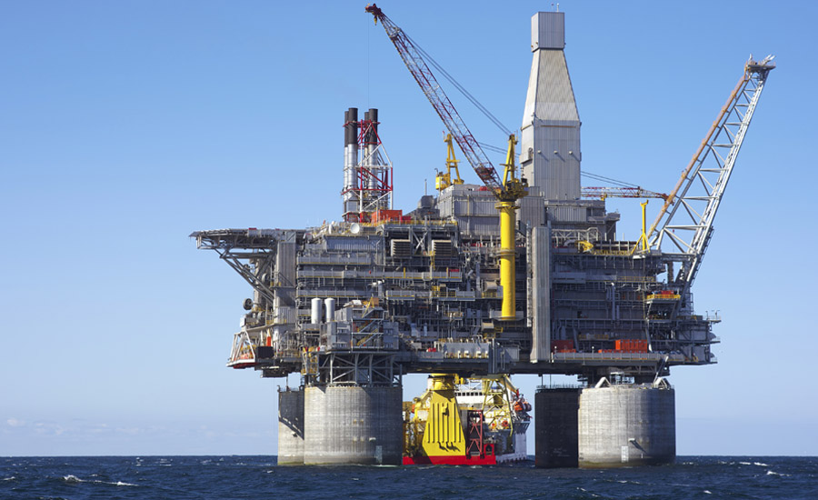
OCEANS PROVIDE ENERGY – OIL AND GAS
Almost half of the world’s oil and natural gas reserves are below the surface of the sea.
Off-shore drilling rigs transfer oil to tankers that take the oil to sites where it is used.

