Slide 1
Repression and non -violent resistance to apartheid
GRADE 9 HISTORY © J. Rich 2021

Slide 2
OUTLINE OF THIS UNIT
When the National Party came to power in 1948 they started passing laws to implement Apartheid and many people started to object and protest against these laws
The following topics will be studied:
Initial protests
Suppression of Communism Act
The ANC programme of action
The Defiance Campaign and the influence of Gandhi
The Freedom Charter
The Treason Trial
The Womens’ March

Slide 3
INITIAL PROTESTS
At first people objected to the laws by writing letters to the press, organizing petitions , and holding demonstrations.
Organizations like the Black Sash were active in this regard

Slide 4
SUPPRESSION OF COMMUNISM ACT
Cold war was dividing the world between pro- and anti- communist governments
Suppression of Communism Act passed in 1950
Communist Party banned
Became a crime to do or say anything that was seen as supporting communism
Newspapers and organizations were banned
People placed under house arrest and banned

Slide 5
ANC PROGRAMME OF ACTION
ANC Youth league formed in 1949 urged the ANC to take a stronger line
ANC adopted a “Programme of Action” including boycotts, strikes, and civil disobedience.
First major action was a May Day strike on 1 May 1950.
Clashes between protestors and police saw 18 protestors killed and led to further protest

Slide 6
DETENTION WITHOUT TRIAL
The government formed the security branch of the police
Changes to the Suppression of Communism Act allowed for people to be locked up for 90 days (later 180 days) without being found guilty in a court of any crime.
People were sometimes tortured while in detention.

Slide 7
DEFIANCE CAMPAIGN - 1952
Various opposition groups joined forces to deliberately break apartheid laws
Aim was to have so many people arrested that that the gaols would be too full and the courts would not cope.
Lasted 3 months and over 8000 people were arrested.
ANC membership rose from 7000 to 100 000
Increased foreign criticism of Apartheid policies
UN set up an enquiry into Apartheid

Slide 8
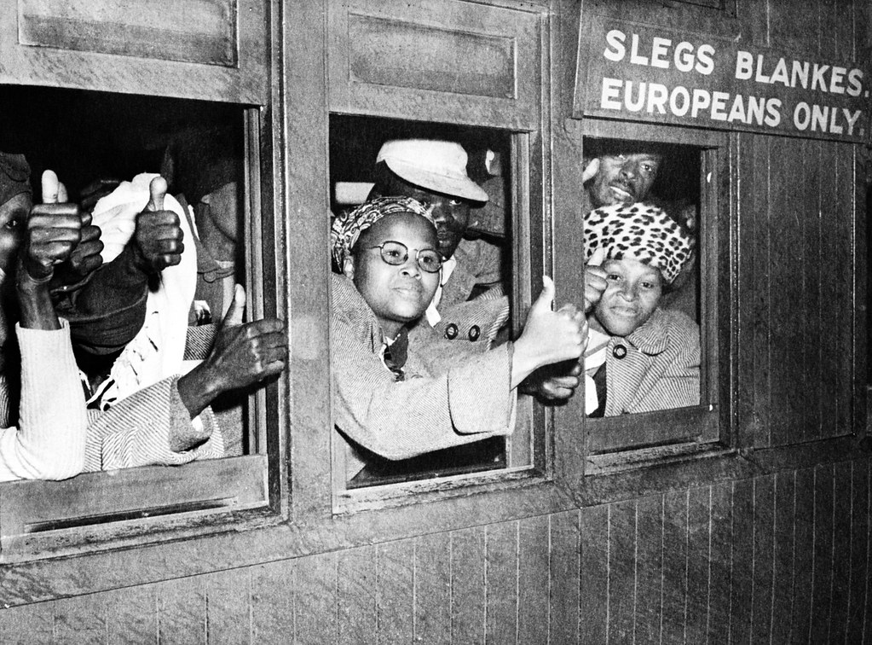

Slide 9
DEFIANCE CAMPAIGN – 1952 - GANDHI
Mahatma Gandhi organized peaceful resistance campaigns to gain independence for India in 1947
His philosophy was called satyagraha
Gandhi inspired the Defiance campaign.
Albert Luthuli was president of the ANC and was deprived of his chieftainship and placed under house arrest after the Defiance Campaign, but was also awarded the Nobel Peace Prize

Slide 10
THE FREEDOM CHARTER
ANC and other groups joined together to form the Congress Alliance
Congress of the People held in Kliptown, Soweto in 1955
Attended by 3000 delegates
Drew up the Freedom Charter
Blueprint for a future non-racial , democratic South Africa

Slide 11
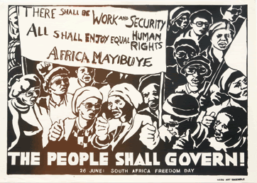

Slide 12
THE WOMEN’S MARCH
Women activists formed FEDSAW (Federation of SA Women)
Protested against pass laws
9 August 1956 20000 women marched to Union buildings
Leaders: Rahina Moosa, Lillian Ngoyi, Helen Joseph Sophie Williams,

