Slide 1
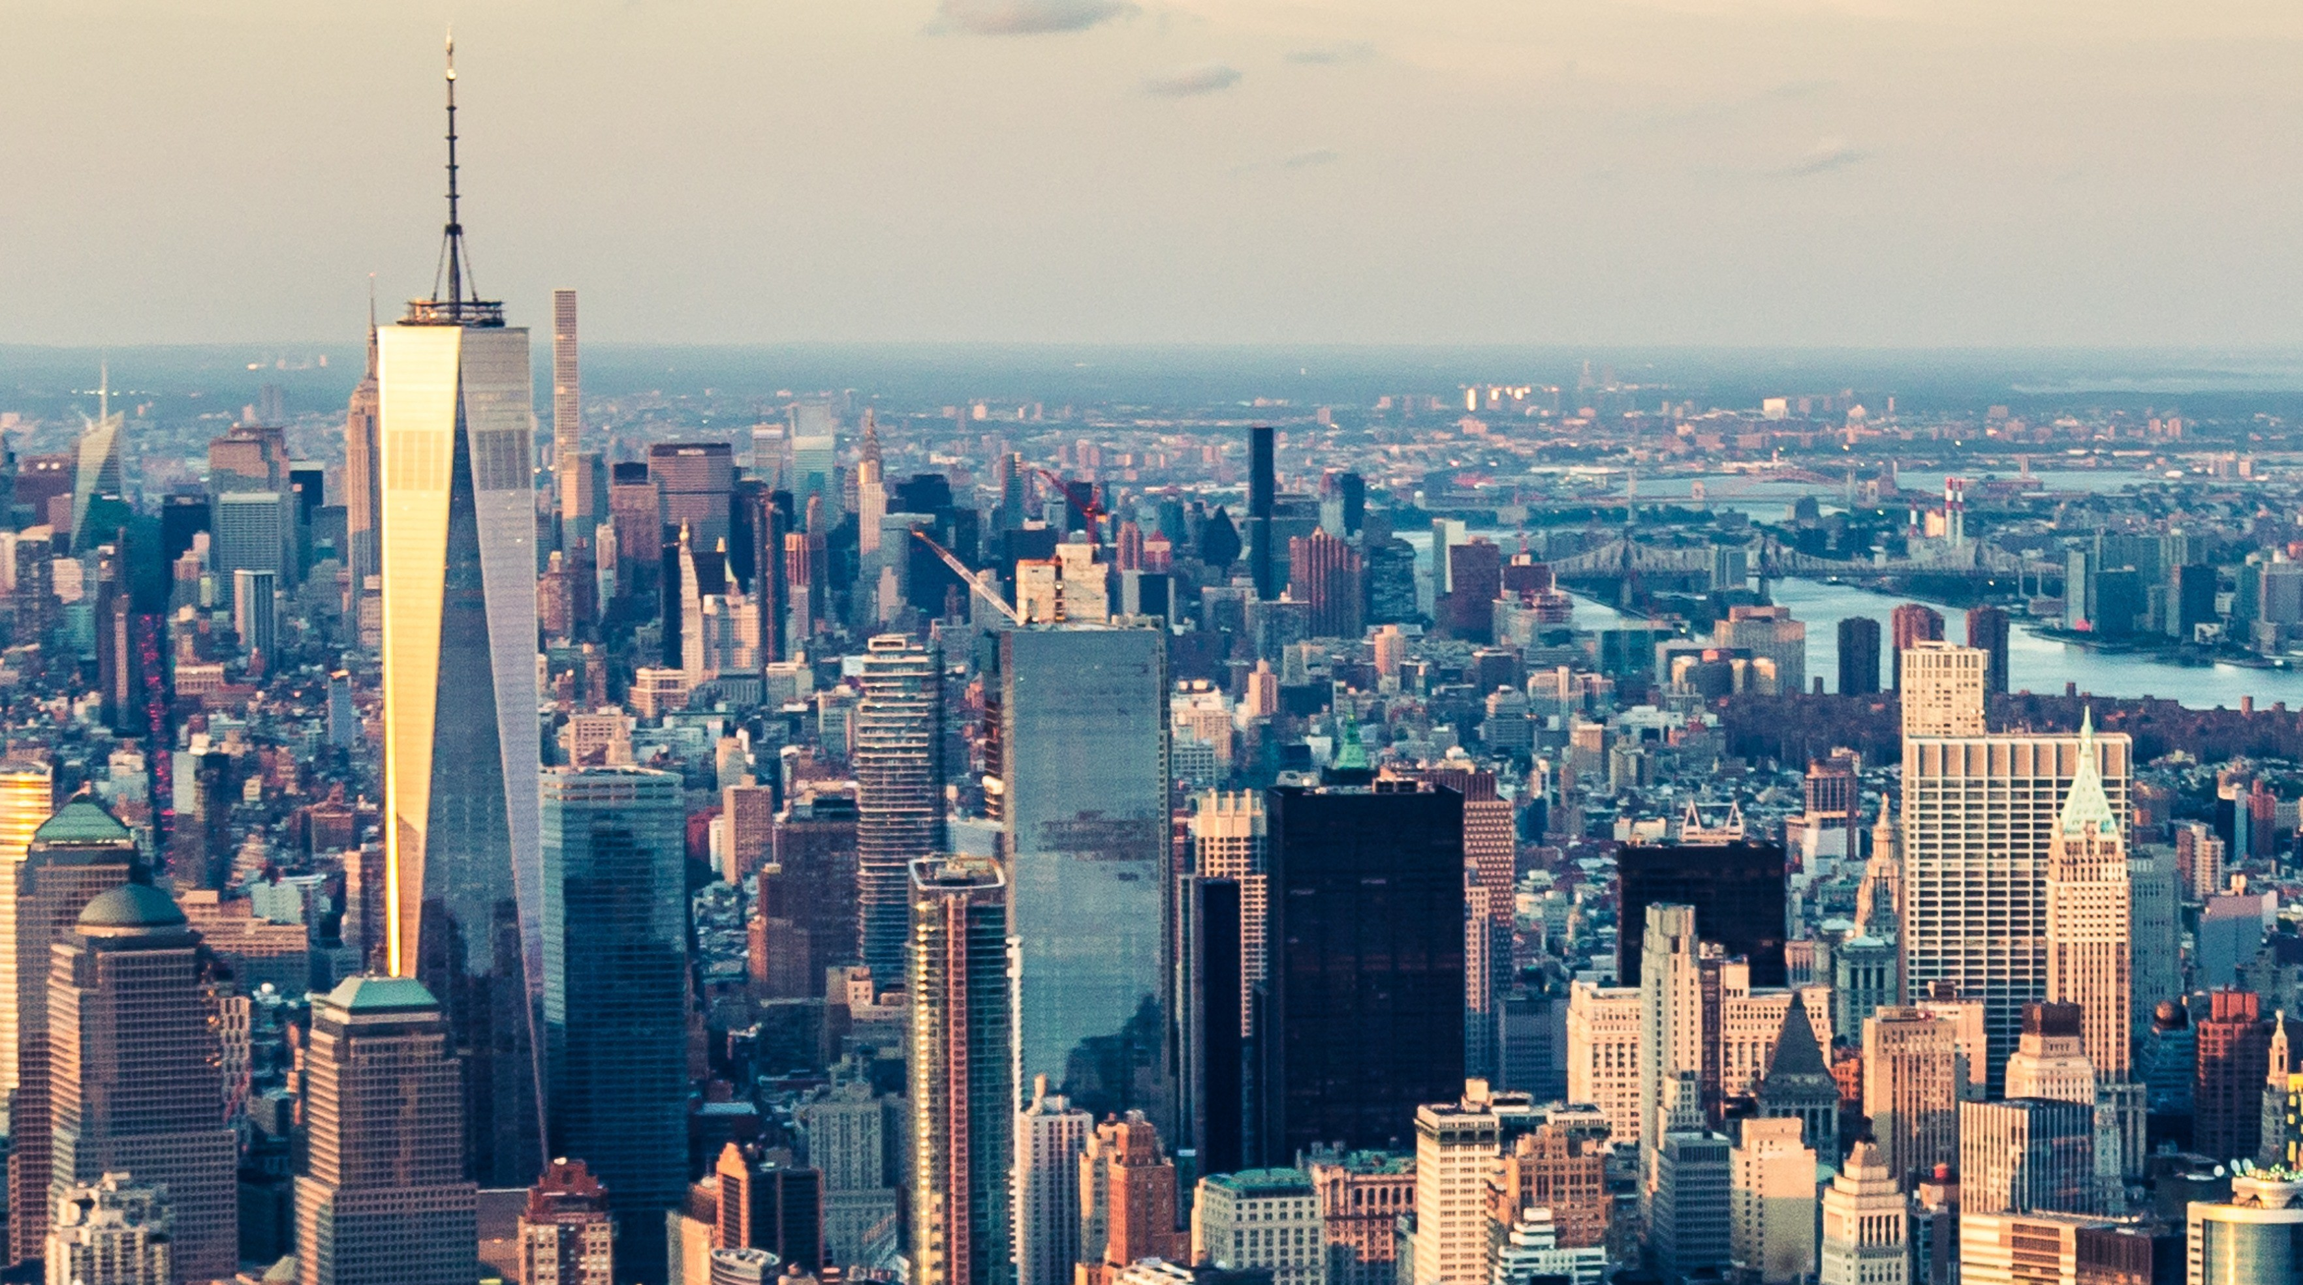
Settlements m3: urban SETTLEMENTS U3: Urban Structure and patterns
Geography grade 12 © j. rich 2021

Slide 2
The big picture
Cities develop for different purposes and reasons, but the land is used in similar ways in all cities

Slide 3
Course overview
Module 1 Nature and types | Module 2 –Rural settlements | Module 3 – Urban settlements
U1: Key concepts: Settlement, site, situation, rural and urban settlements W1 | U1: Role of site and situation, classification, function W2 | U1: Origin, development and classification of urban settlements W5
U2: Classification of settlements W1 | U2: Settlement shapes and land use W2 | U2: Urban hierarchies W5
 | U3: Rural settlement issues W3 | U3: Urban structure and patterns W5
 |  | U4: Urban settlement issues W6

Slide 4
Land use zone
Specific area of a city where one particular land use or activity is dominant
Layout of different zones in relation to each other creates a unique urban pattern

Slide 5
Central business district (Cbd)
In city centre
High accessibility
Demand for land is high so cost of land is high
Cost reduced by use of tall, high-rise buildings
Commercial heart of city
Subject to decay over time
Decentralisation into outlying business districts (OBDs)

Slide 6
Transition zone
Adjacent to CBD
Mixed residential, light industrial, and commercial use
Often subject to urban blight as people move out

Slide 7
Residential zones
Vary according to plot size and density.
Lower income housing is cheaper and more dense. More apartments.
Larger plots and more space is more expensive hence higher income housing.
Related amenities linked to income levels e.g. golf course near high income residential, community hall or taxi rank in low income zones

Slide 8
Industrial zone
Light industries such as clothing manufacture or spray painters may be located in transition zone or suburbs.
Heavy industries will be located on city outskirts or close to harbours or rail connections in specially demarcated zones.
A more recent development in cities is dedicated industrial development zones (IDZ) and industrial parks wherethe necessary infrastructure is optimised

Slide 9
Rural–urban fringe
On outskirts of the city where the urban growth is infringing on rural land.
Characterised by mixed land use

Slide 10
Recreation zone
Parks, zoos, golf courses, sports grounds and botanical gardens provide green zones in the city that serve a healthy purpose for people and the environment
Relaxation and recreation
Conservation, carbon reduction, temperature regulation

Slide 11
Factors pushing or pulling people in relation to the CBD
Centrifugal forces push people away from the city centre and include high land prices, crime and congestion.
Centripetal forces pull people towards the city centre and include accessibility, convenience, prestige and historical relevance

Slide 12
Factors affecting location of land use zones
Accessibility to users
Land values
Special requirements
Compatibility
Planning and zoning
Centrifugal and centripetal forces

Slide 13
Urban profile

Slide 14
Morphological structure
Morphology = shape or pattern created by a city on the surface of the land
Profile = side view / Morphology = top view
Three aspects:
General shape
Street pattern
Planning

Slide 15
Shape of cities

Slide 16
Urban hierarchy model

Slide 17
cENTral places
Central place = an urban settlement that provides goods and services to surrounding rural areas
Not all central places can provide the same range of goods and services
Places higher on the urban hierarchy can provide more specialized and a greater range of goods and services than those lower down
Direct relationship between number of central places and the number of functions offered i.e. the higher in the hierarchy the fewer the central places

Slide 18
Threshold population
Minimum number of people to sustain or make a function profitable
More frequently the function is required the lower the threshold
Goods with a low threshold population will have a low sphere of influence

Slide 19
Sphere of influence
Area from which a function draws its users or customers.
The more often a service or product is required the smaller the sphere of influence

Slide 20
range
Maximum distance a user or customer is prepared to travel to access a function
Lower the threshold the lower the range

Slide 21
Lower and higher order functions
Lower order functions and goods
Higher order functions and goods
Relatively cheap and easy to access and supply
Often used spontaneously
Used frequently – almost every day
Also called convenience goods
More expensive and specialized
Usually require some decision-making to acquire
Used less often
Also called comparative goods

Slide 22
Lower and higher order centres
Lower order centres offer mostly lower order functions
Lower order centres may occur close to each other
Higher order centres offer higher order functions and tend to be far apart

