Slide 1
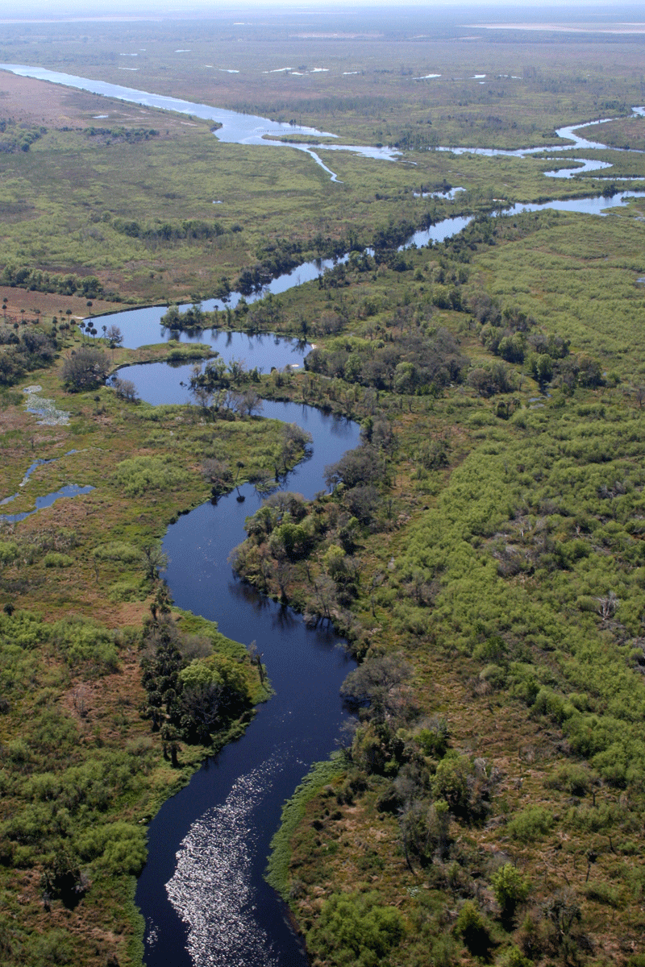
Geomorphology – rivers m2: FLUVIAL PROCESSES U4: RIVER capture
Geography grade 12 © j. rich 2021

Slide 2
Course overview
Module 1 Drainage systems | Module 2 –Fluvial processes | Module 3 – Catchment and river management
U1: Importance of studying rivers Defining a stream Key concepts Types of rivers W1 | U1: River profiles Stages of a river River grading W4 | U1: Importance of managing drainage basins and catchment areas W8
U2: Drainage patterns Drainage density W2 | U2: Fluvial landforms W5 | U2: Human impact on drainage basins and catchment areas W8
U3: Stream order and density River discharge Laminar and turbulent flow W3 | U3: River rejuvenation W6 | U3: Case study W9
 | U4: River capture U5: Superimposed and antecedent drainage patterns W7 | U4: Test W9

Slide 3
LEARNING OVERVIEW
In this lesson you will learn about two forms of river capture, what causes them, and how they present.
Key terminology you will need to master from this unit is:
river capture stream piracy
abstraction headward erosion
headwaters elbow of capture
wind gap knickpoint
captor stream captured stream
misfit stream

Slide 4
What is river “capture”?
Adjacent rivers are separated by watersheds of rock
If watershed is eroded through one river connects with and diverts another
This is river capture or stream piracy

Slide 5
HEADWARD EROSION

Slide 6
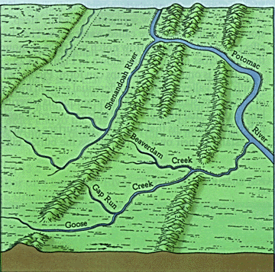
ABSTRACTION
When there are streams on opposite sides of a watershed and one of the streams is more overgraded than the other, it will erode backward (headward) and capture the less graded stream.
In the example alongside Beaverdam Creek is tending towards capturing the Shenandoah River

Slide 7
RIVER CAPTURE TERMS

Slide 8
POSSIBLE CAUSES OF STREAM PIRACY
1. Greater volume in the capturing stream due to increased rainfall or climate change
2. Unequal rock resistance – one side of the watershed has harder rock than the other and the river where the rock is softer will erode more quickly
3. Human intervention e.g. dams
4. Geological activity such as earthquakes can alter river flow or volume

