Slide 1
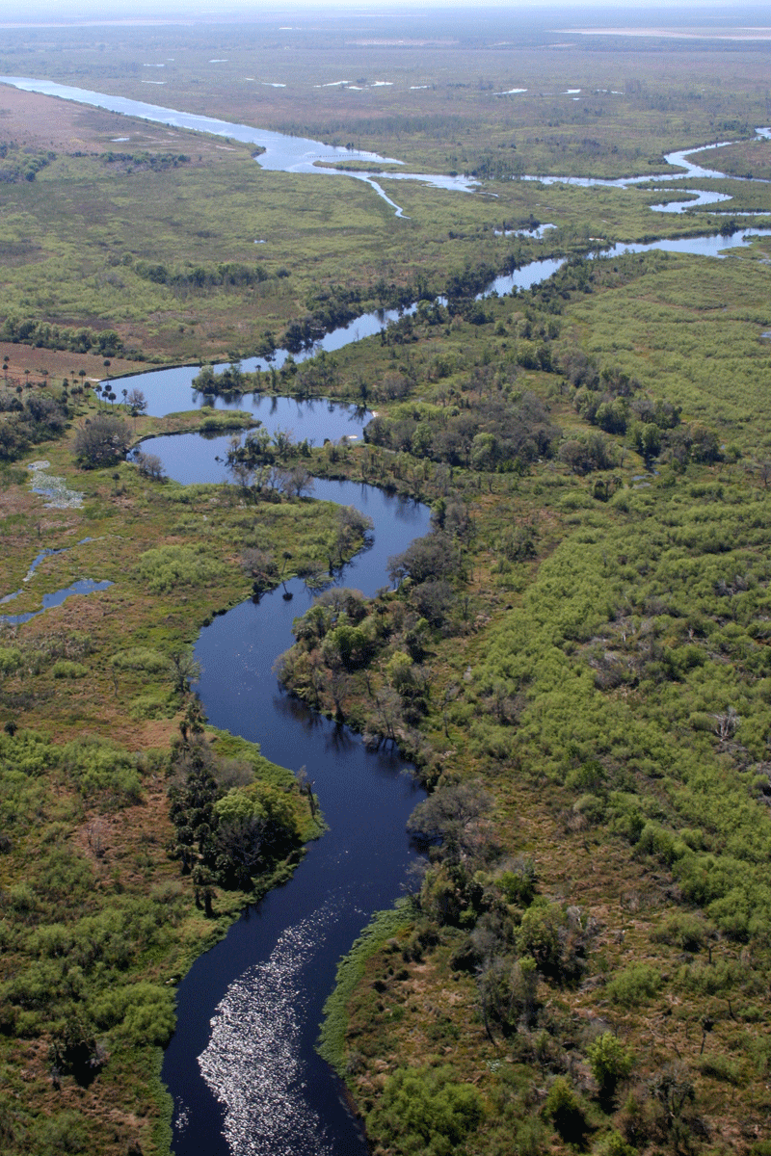
Geomorphology – rivers m2: FLUVIAL PROCESSES U2: FLUVIAL LAND FORMS
Geography grade 12 © j. rich 2021

Slide 2
Course overview
Module 1 Drainage systems | Module 2 –Fluvial processes | Module 3 – Catchment and river management
U1: Importance of studying rivers Defining a stream Key concepts Types of rivers W1 | U1: River profiles Stages of a river River grading W4 | U1: Importance of managing drainage basins and catchment areas W8
U2: Drainage patterns Drainage density W2 | U2: Fluvial landforms W5 | U2: Human impact on drainage basins and catchment areas W8
U3: Stream order and density River discharge Laminar and turbulent flow W3 | U3: River rejuvenation W6 | U3: Case study W9
 | U4: River capture Superimposed and antecedent drainage patterns W7 | U4: Test W9

Slide 3
The big questions In this unit
How do streams impact on and change the appearance of the earth’s surface.
How are a range of land forms created through erosion and deposition by rivers

Slide 4
FACTORS THAT AFFECT RIVER IMPACT AND ENERGY
VELOCITY Faster = more erosion; slower = more deposition
VOLUME Greater volume = greater impact
GRADIENT Steeper = more erosion; flatter = more deposition
FRICTION More friction more energy loss

Slide 5
waterfalls
Forms when stream crosses hard, resistant rock then reaches softer rock

Slide 6
rapids
Formed by alternating layers of hard and soft rock.
Important for health of the stream by aerating the water
Tourism value

Slide 7
meanders
In lower course slower flow causes river to wind around obstacles
Deposits on slower moving inner side and erods more on faster flowing outer side

Slide 8
meanders
A

Slide 9
Oxbow lake
Forms when a meander is cut off during a flood and a new channel is formed
Can become wetlands and are ecologically important

Slide 10
Floodplain and natural levee

Slide 11
Braided stream

Slide 12
delta
River enters a larger body of water and deposits its load
No strong current to wash deposition away
Blockages lead to distributaries

Slide 13
Types of delta
ARCUATE
BIRD’S FOOT
ESTUARINE
CUSPATE

