Slide 1
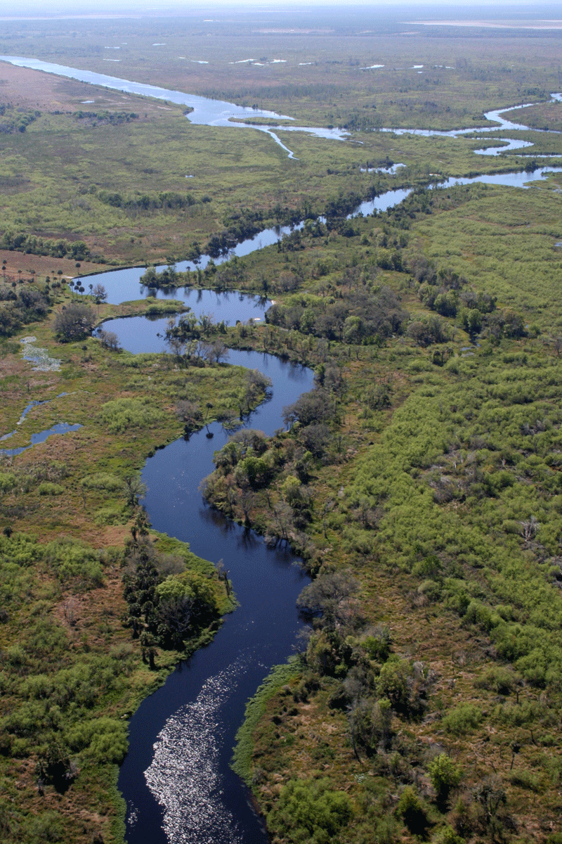
Geomorphology – rivers m1: drainage systems
U3: stream order aNd DENSITY
Geography grade 12 © j. rich 2021

Slide 2
Course overview
Module 1 Drainage systems | Module 2 –Fluvial processes | Module 3 – Catchment and river management
U1: Importance of studying rivers Defining a stream Key concepts Types of rivers W1 | U1: River profiles Stages of a river River grading W4 | U1: Importance of managing drainage basins and catchment areas W8
U2: Drainage patterns Drainage density W2 | U2: Fluvial landforms W5 | U2: Human impact on drainage basins and catchment areas W8
U3: Stream order and density River discharge Laminar and turbulent flow W3 | U3: River rejuvenation W6 | U3: Case study W9
 | U4: River capture Superimposed and antecedent drainage patterns W7 | U4: Test W9

Slide 3
The big questions In this unit
How do different tributaries contribute to the strength and volume of a river downstream?
Which tributaries make the biggest contribution to the river?
How does water flow in a stream?
How do we calculate how much water is flowing in a river at a particular point?

Slide 4
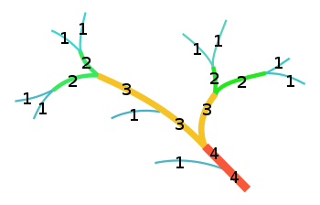
Stream order
Several different systems in place – we use Strahler method.
One more than the 2 highest order tributaries into a stream e,g,2 or more 2 > 3

Slide 5
Stream discharge
How much water is moving through the stream channel in a given period of time.
Q = V x W x D (Velocity X Width X Depth)

Slide 6
Types of flow
Laminar – Smooth parallel stream of molecules, little or no mixing
Turbulent – Swirls and eddies with much mixing
Helical – Spiral flow resulting in deposition

Slide 7
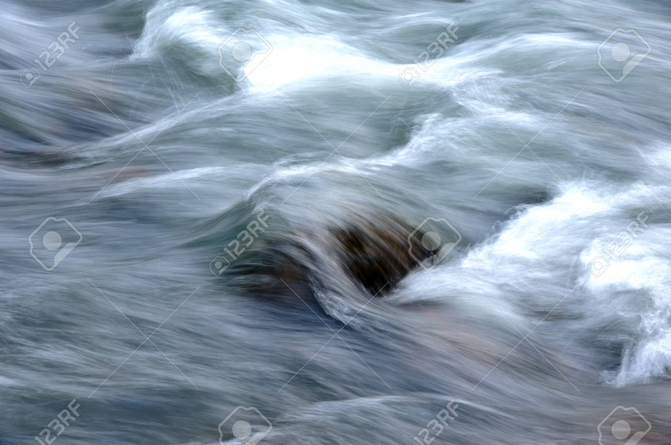
Activity 1
What type of flow is illustrated alongside?
What are possible reasons for this type of flow?

Slide 8
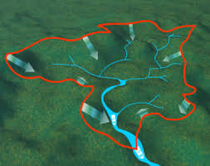
Activity 2
Calculate the order of the stream at point A
If the depth of the water at poit A is 2m, the river is 4 m wide ad the water flows past there at 3m/s what is the discharge?
A

