Slide 1
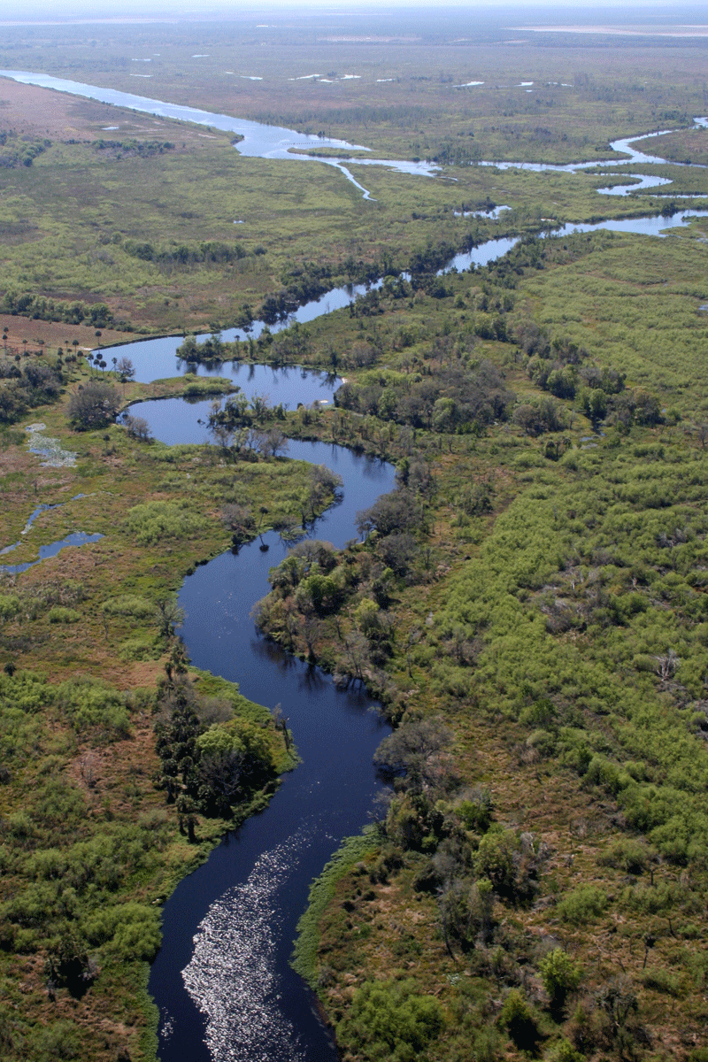
Geomorphology – rivers m1: drainage systems
U2: DrAINAGE PATTERNS AND DRAINAGE DENSITY
Geography grade 12 © j. rich 2021

Slide 2
Course overview
Module 1 Drainage systems | Module 2 –Fluvial processes | Module 3 – Catchment and river management
U1: Importance of studying rivers Defining a stream Key concepts Types of rivers W1 | U1: River profiles Stages of a river River grading W4 | U1: Importance of managing drainage basins and catchment areas W8
U2: Drainage patterns Drainage density W2 | U2: Fluvial landforms W5 | U2: Human impact on drainage basins and catchment areas W8
U3: Stream order and density River discharge Laminar and turbulent flow W3 | U3: River rejuvenation W6 | U3: Case study W9
 | U4: River capture Superimposed and antecedent drainage patterns W7 | U4: Test W9

Slide 3
WHY STUDY DRAINAGE PATTERNS
The number and volume of tributaries determines the strength and volume of the river downstream
Damming or deviating a stream can have serious consequences for the river further down if it is the major feeder
Can help us predict and prevent flooding
Gives clues as to underlying rock structure

Slide 4
What is drainage pattern?
The pattern of a river system when seen on a map.

Slide 5
4 main types of drainage pattern
Dendritic – run off from various points towards a single large stream down a uniform valley
Rectangular – down a valley with hard underlying rock with faults – several parallel streams that gradually converge
Radial - from a central high point in many different directions
Centripetal – From many different direction to a central low point

Slide 6
Drainage density
How quickly rainfall and snowmelt enters streams and returns to the sea.
High density = little water remains in the soil and much flows away
Low density = much water is retained in the soil

Slide 7
Calculating DRAINAGE density
Total distance of all subsidiary streams (km)
Total area of the basin (sq. km)
Bigger ratio = higher density

Slide 8
Why determine drainage density
Type of vegetation or crops – Different plants require more or less soil moisture
Type of land use or construction

Slide 9
Factors determining drainage density
Rainfall – Higher
Relief - Steeper
Resistance of underlying rocks - Harder
Permeability – Less porous
Vegetation - Sparser

