Slide 1
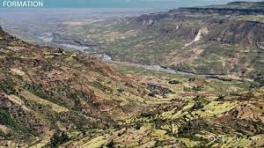
CLIMATE AND WEATHER 4 – VALLEY CLIMATES
Unit 1 – The micro-climate of valleys
Geography grade 12
© j. rich 2020

Slide 2
REVIEW – WHAT HAVE YOU ALREADY LEARNED?
1 minute
The most important source of energy in the atmosphere is insolation (incoming solar radiation)
As air warms pressure drops causing cooler air to flow in
When warm air forms a layer above cooler air trapping the cold air we call it a temperature inversion

Slide 3
Overview – what you will learn
1 minute
After you have finished this unit you should be able to:
Explain and identify the three important factors that influence climate in valleys
Explain how and why weather conditions vary significantly between day and night in valleys
Explain the terms anabatic and katabatic
Describe and explain the phenomenon of frost pockets
Explain what radiation fog is and what causes it
Describe how the features of valley climates influence human activities

Slide 4
UNIQUE FACTORS THAT AFFECT CLIMATE IN VALLEYS
1 minute
Aspect (slope)
Anabatic and katabatic winds
Inversions

Slide 5
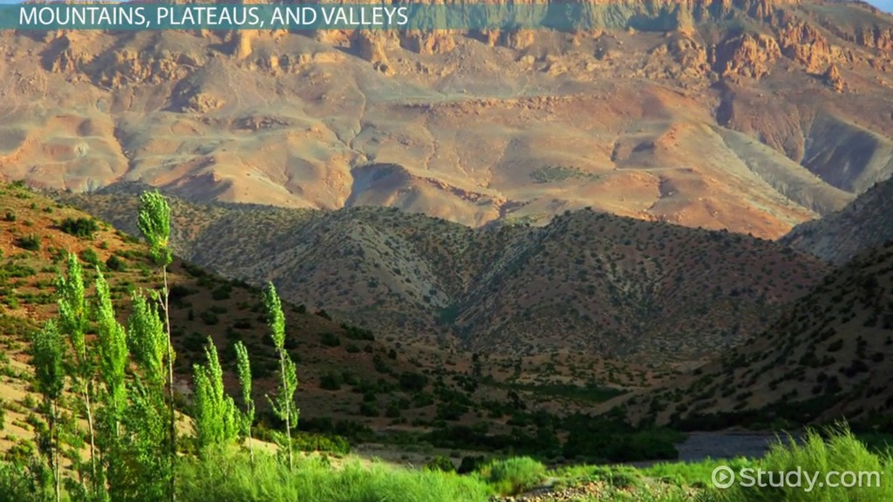
ASPECT
3 minutes
In the picture alongside it can be clearly seen that:
The upper part of the north slope of the valley has already been warmed by the sun for a while (A)
The sun will slowly warm the lower parts of the north slope (B)
The south slope will remain in shadow for most of the day and may not even get any sunlight (C) (Called a shadow zone
The areas getting most sunlight heat up the most and experience the most evaporation
A
B
C

Slide 6
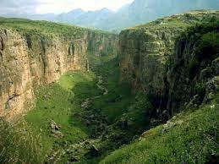
ASPECT (CONTD.)
In the picture alongside identify:
The warmest part of the valley
The south slope (this is a South African scene)
The shadow zone
The area likely to only get afternoon sun
B
C
A

Slide 7
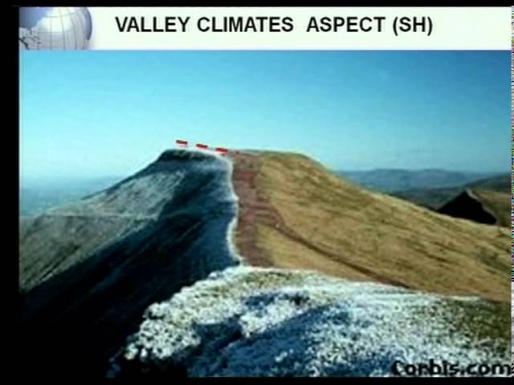
ASPECT (contd.)
In the picture alongside:
The north facing slope (A) is in bright sunlight and has no snow
The south facing slope (B) only has partial sunlight and is snow covered.
The shadow zone (C) receives no sunlight and will be the coldest part of the mountain
A
C
B

Slide 8
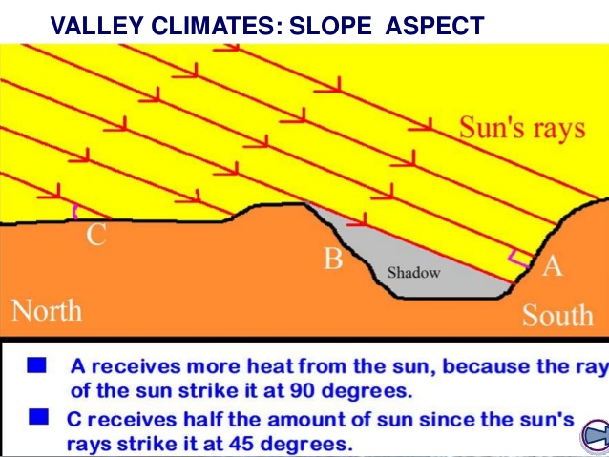
ASPECT (contd.)
The diagram alongside is based on the northern hemisphere. In the southern hemisphere north and south swop places

Slide 9
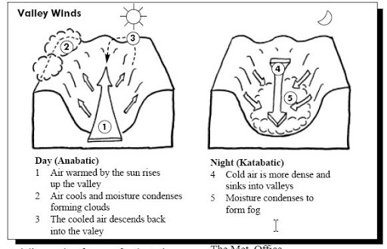
Anabatic and katabatic winds

Slide 10
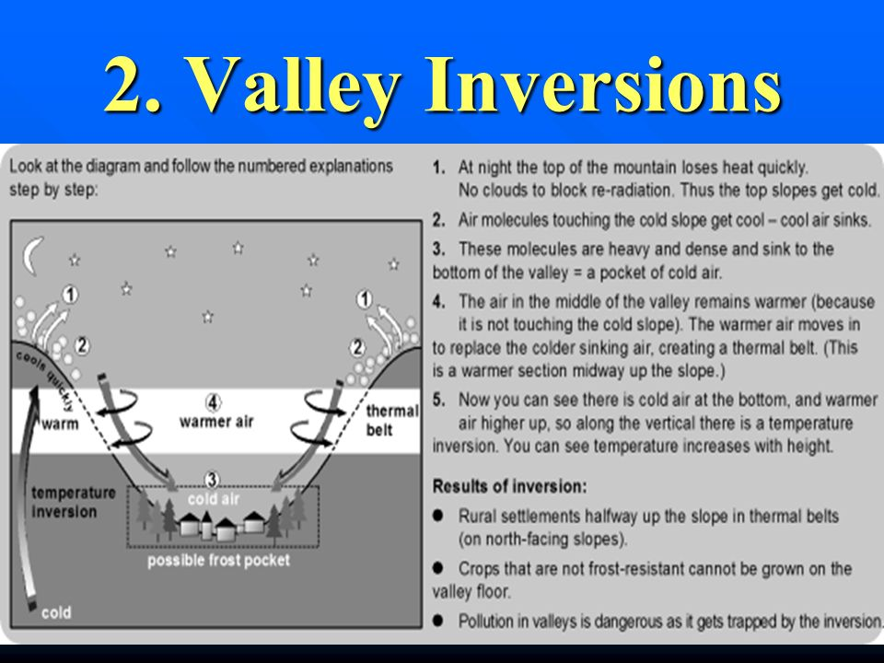
inversions

Slide 11
Frost pockets
If water vapour cools to dew point temperature it condenses.
If dew point temperature is 0 deg C the water freezes = frost
Frost pockets from in valley floors. Many plants and crops cannot survive frost while some like citrus actually welcome a spell of frost.

Slide 12
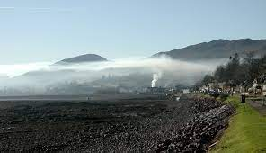
Radiation fog
Fog forms when water vapour reaches dew point temperature above 0 deg. C
The earth is cooled through loss of long wave radiation at night so it is called radiation fog.
After sunrise the air is gradually warmed and the fog disperses through evaporation

Slide 13
How does aspect affect human activity
People prefer to settle on north-facing slopes and to build buildings facing north in the southern hemisphere
Some crops prefer more heat and thrive better on north slopes

Slide 14
Influence of temperature inversion
Warm inversion layer traps pollution and smoke causing a pollution plume and smog
The high concentration of pollutants can cause acid rain
Frost pockets pose challenges to farmers

