Slide 1
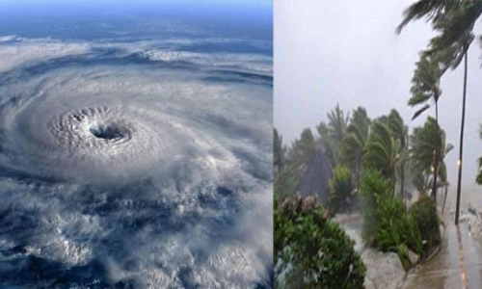
CLIMATE AND WEATHER 2 – TROPICAL cyclones Unit 3 – Associated weather conditions
Geography grade 12
© j. rich 2020

Slide 2
REVIEW – WHAT YOU HAVE ALREADY LEARNED
1 minute
Tropical cyclones have a very low pressure centre and a wall of cumulonimbus cloud around the eye.
They pass through four stages of development.
They depend on high sea temperatures to promote evaporation and causing low pressure.
The move rapidly over the sea because of low friction but dissipate when they reach landfall

Slide 3
Overview – what you will learn
After you have finished this unit you should be able to:
Distinguish between weather conditions at the centre and the outer edges of a tropical cyclone
Explain the concept of active quadrant and describe weather conditions there
Describe the types of cloud formations associated with tropical cyclones

Slide 4
Cross-section of a tropical cyclone
The eye is gently subsiding air; there is no rain or wind and the sky is clear. It is usually around 25km in diameter
On all sides of the eye the rising warm air forms dense high (15km) walls of cumulonimbus clouds. There is very heavy rain and high wind speed.
Beyond the eyewall for up to 100km there is high wind and altostratus and cirrus clouds. There may also be some heavy rain

Slide 6
ACTIVE QUADRANT
Wind direction changes around the tropical cyclone. Why?
The cyclone is moving in a specific direction while it spirals.
When the wind direction and the travel direction coincide the winds are strongest and the weather is worst – called active quadrant.
Active quadrant is south west in southern hemisphere and northwest in northern hemisphere

Slide 7
THE QUADRANTS OF A TROPICAL CYCLONE
This diagram is for a hurricane in the northern hemisphere. How would it differ in the southern hemisphere?

Slide 8
Check your understanding Copy and complete the table below
 | In first eyewall | In eye | In second eyewall
Air pressure | Decreases
Wind speed |  |  | Increases
Wind direction | South/ southwesterly | No wind
Temperature
Clouds | Tall cumulonimbus
Rainfall | Very heavy

Slide 9
Check your understanding
What kind of clouds do you first observe as the tropical cyclone approaches?
How far away from the eye could rain fall?
Why is it warmest in the eye?
Why is the wind direction opposite on each side of the eye?

