Slide 1

AMERICAN CAPITALISMThe roaring 20s
HISTORY GRADE 11 © J.RICH 2021

Slide 2
WHAT THIS MODULE IS ABOUT
Politics and power throughout most of the twentieth century was dominated and shaped by two competing ideologies:
            Communism
            Capitalism
You have already studied the first of these. This module looks at how the second in terms of three important stages:
    The economic boom of the 1920s
    The economic crash of the 1930’s and
    The economic recovery under Roosevelt

Slide 3
WHAT YOU KNOW ABOUT COMMUNISM
Marx rejected the Capitalist theories of wealth formulated by Adam Smith
Proposed that all ownership should be with the state and wealth should be equally distributed to all workers
Lenin and Trotsky applied Marx’s theories in Russia after the 1917 revolution
Stalin later adopted a more autocratic control and used 5 year plans to push productivity

Slide 4
WHAT YOU WILL LEARN IN THIS UNIT
After completing this unit you should be able to:
Identify characteristics of American society that favoured a particular form of capitalism
Explain what factors and events at the time influenced America’s economy and society
Explain how the factors that helped America to grow wealthy also made her vulnerable to lose wealth
Explain what prohibition was and how it influenced American society

Slide 5
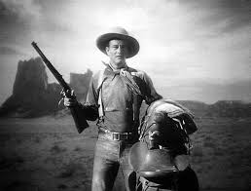
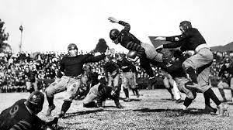

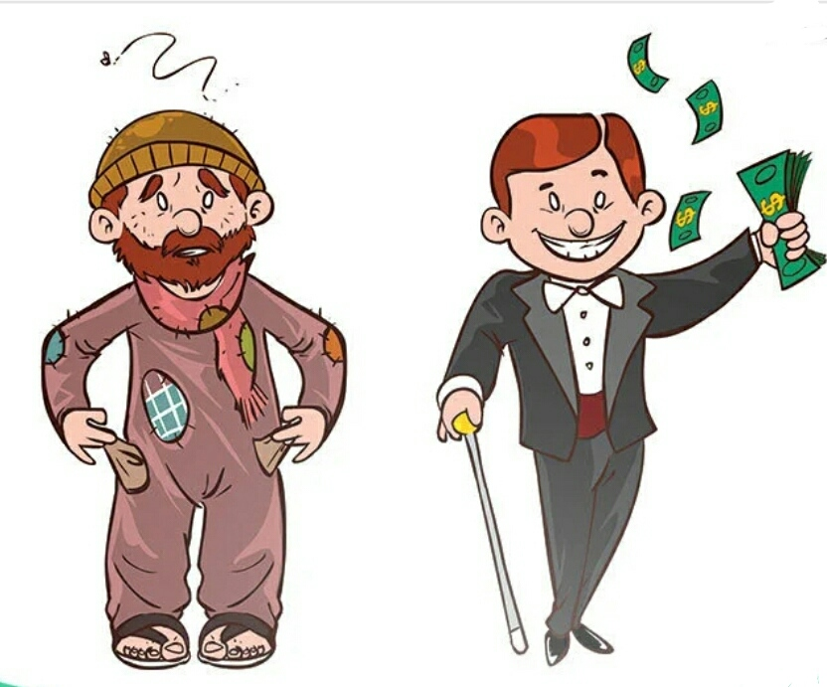
AMERICAN VALUES IN THE 1920’S
Pioneering spirit – rugged individualism
Competitive and entrepreneurial
“Land of the free”
American dream -
rags to riches

Slide 6
FACTORS THAT INFLUENCED THE ECONOMY
WW1- USA entered late emerged economically stronger than other countries
Urbanisation – USA was changing from a mostly rural to a mostly industrial, urban society
Free market – minimal control or interference in the economy
Shifting identity of women

Slide 7
THE BOOM
Economy grew by 42%
Electrification, automobile and aircraft industries grew
Manufactured goods and technology became household items
Strong urbanization and agriculture shrank
Tax rates dropped
Real GDP grew by $290billion from 1920-1929
Stock market grew with share prices rising greatly

Slide 8
WEAK SPOTS
Banks
      Many outside of federal reserve – depended on each other for reserves.
      Fictitious reserves
      Easy credit
      Exchanged cash for securities
Stock exchange
      Allowing trading on the margin
Black market
      No tax
Shrinking agricultural economy
      Food prices rose during drought

