Slide 1
Germany in the 1920’s
History g 8 © Johan Rich 2021

Slide 2
End of an Empire
Kaiser overthrown and forced to go into exile after the war
Democracy with greater freedom for poorer classes under the new Weimar Republic
Punishment and humiliation of the peace treaty (Versailles)
Economic hardship

Slide 3
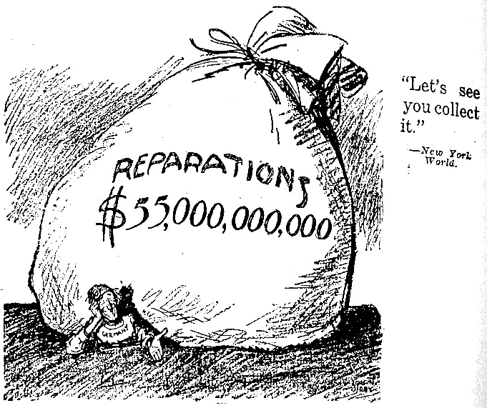
Economic burdens
Who is the figure under the bag?
What does the bag represent?
What does the cartoon suggest is happening?
How would this have made Germans who fought in the war feel?

Slide 4
Hitler – the early 1920’s
Adolf Hitler – Austrian born ex-soldier
1920 Joined National Socialist German Workers Party (Nazi Party)
1923 Led a group of Nazi’s in an uprising in Munich to overthrow the government Beer Hall Putsch
Imprisoned and wrote Mein Kampf
1926 Released from prison took the lead in the Nazi party
1928 Nazi Party did poorly in election (12 seats out of 472)

Slide 5
Some key questions
1. Why were many Germans unhappy with the terms of the peace treaty?
What are some of the dangers of punishing the “losers” in a conflict?
2. Why was Hitler in prison when he wrote Mein Kampf?
What is a good way to deal with dangerous political troublemakers?
3. Why would it be important for historians studying this period to read Mein Kampf?
What is a primary source?
4. Who could Germans blame for Germany accepting the peace treaty?

