Slide 1

Climatology – m2 global air circulation– World pressure patterns (unit 3)
© johan rich 2021 geography grade 11

Slide 2
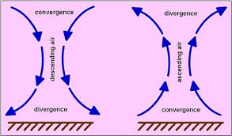
HOW AIR MOVES – VERTICAL AND HORIZONTAL MOVEMENT
When air sinks from upper atmosphere towards the surface it warms and moves apart on the surface (divergence)
When air at the surface rises and cools aloft and also diverges while the lower pressure at the surface also causes air to flow inwards (convergence)

Slide 3
What is air pressure
The weight of all the air in the atmosphere pressing on the surface of the earth.
The amount of air molecules in a space (density)
The higher the altitude, the more the molecules spread out and the less dense.
The higher the temperature the more the molecules move and spread apart (the air expands) leading to lower pressure
The colder the temperature the more the molecules move together (contracts) and slow down causing a higher pressure

Slide 4
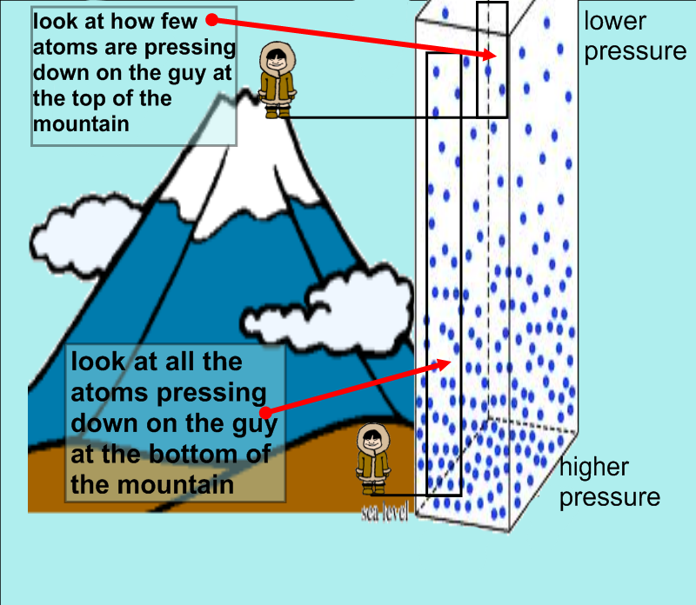
Link between air pressure and altitude

Slide 5
principles of up and downward air movement
Air masses of different temperatures will not mix – colder, heavier air undercut warm air mases and force them upward
Cold air at top of troposphere is heavy and dense and sinks compressing the air below it.
Compressing air makes it warmer and denser
Sinking air warms (adiabatic warming) rising air cools (katabatic cooling)
Sinking air = high pressure = stable conditions / rising air = lpw pressure = unstable conditions

Slide 6
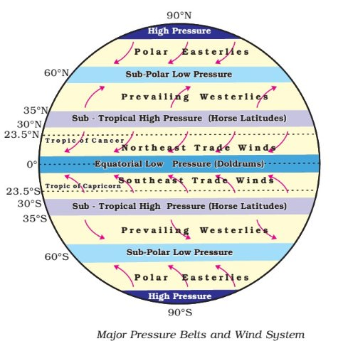
World pressure belts
The equatorial low pressure belt is also called the inter-tropical convergence zone (ITCZ)

Slide 7
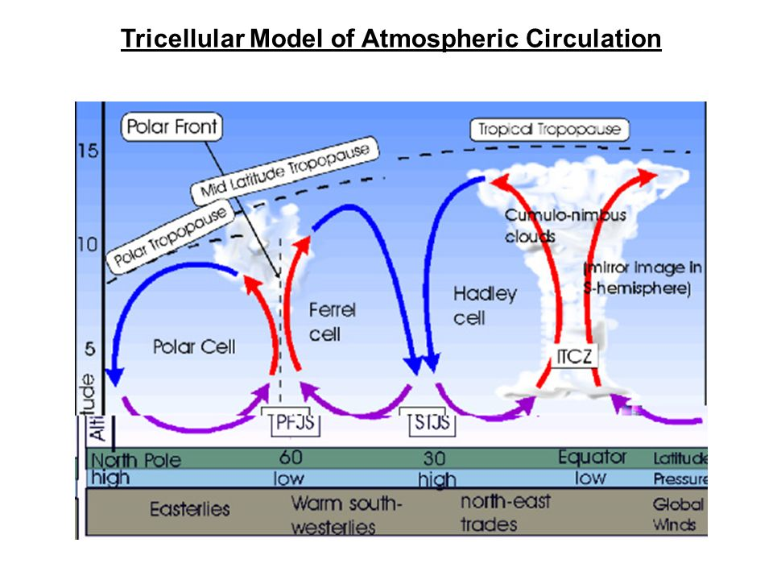
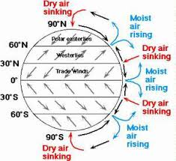
Tri-cellular circulation

