Slide 1
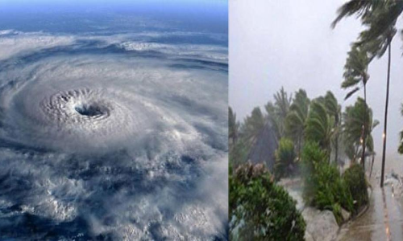
CLIMATE AND WEATHER 2 – TROPICAL cyclones Unit 1 – Characteristics and location of tropical cyclones
Geography grade 12
© j. rich 2020

Slide 2
REVIEW – WHAT YOU HAVE ALREADY LEARNED
1 minute
Cyclones are weather systems that revolve around a low pressure cell and produce high winds and heavy rains. Air converges (rushes into) the low pressure cell, rises, and diverges in the upper air.
Mid-latitude cyclones occur when warm tropical air meets cold polar air causing low pressure cells to form. They last about a week and travel great distances very rapidly.
The life-cycle of mid-latitude cyclones goes through five distinct stages related to the interaction between warm and cold air masses

Slide 3
Overview – what you will learn
After you have finished this unit you should be able to:
Describe and explain the 7 characteristic features of tropical cyclones
Distinguish the differences between tropical cyclones ad mid-latitude cyclones
Identify on a map the areas where tropical cyclones occur and explain why they occur there.
Describe and explain 3 critical factors that are needed for tropical cyclones to form.
List the names used for tropical cyclones in different parts of the world
Define and explain the concept latent heat

Slide 4
distinctive characteristics of tropical cyclones
2 minutes
How do they happen? | Develop in a warm, moist air mass. Not associated with fronts.
How much (pressure) ? | Very low pressure at centre (around 960 hPa and sometimes as low as 870 hPa)
How big? | Diameter of about 600-1000 km (Smaller than mid-latitude cyclones)
How fast? | Travel at about 10-20 km/h (around 200 km / day) in a westward direction (slower than MLC)
How long do they last? | About 7 days and less if they reach land
What shape? | Isobars are almost circular around centre

Slide 5
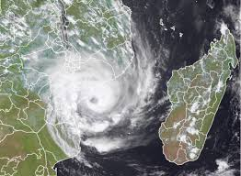
Characteristic appearance of tropical cyclones

Slide 6
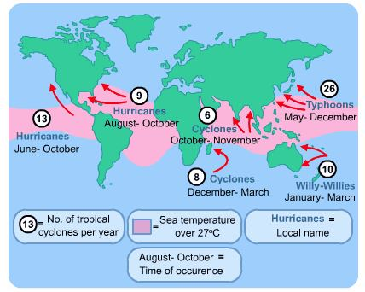
Where tropical cyclones occur

Slide 7
Where tropical cyclones form
In tropical latitudes (between 5 deg and 20 deg S and N)
Driven by tropical easterly winds
Form over warm oceans
Form on eastern side of continents (why?)
Move east to west but later veer towards poles steered by high pressure sub-tropical cells

Slide 8
Naming of tropical cyclones
Officially named once wind speeds reach 65 km/h.
Named in alphabetical order alternating male and female
Regional terms: East Asia – Typhoons
Indian Ocean – Cyclones
Americas and Caribbean – Hurricanes
Australia – Willy-willies

Slide 9
Factors needed to form a tropical cyclone
Warm sea surface
Coriolis force
Upper air divergence

Slide 10
Why warm sea surfaces help formation of tropical cyclones
Temperature above 26⁰ causes evaporation ad rapid rising of temperature.
Evaporation releases latent heat energy
Latent heat warms the air and causes it to rise causing a drop in pressure
Results in surface convergence and upper air divergence

Slide 11
Role of the Coriolis force
Coriolis force causes the wind to “curve” and hence produces the rotation around the low pressure zone
Coriolis force is weak around the equator so tropical cyclones do not occur between 0⁰ and 5⁰ N or S.

Slide 12
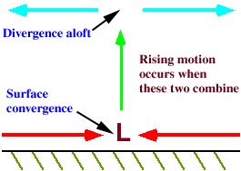
Upper air divergence
Warm air rises causing low pressure
Cooler air flows in to the low pressure zone (Surface convergence) but gets warmed up there
Hot air cools at high altitude and moves away (divergence)
This draws up more of the warmed air from below

Slide 13
Check my learning
Tropical cyclones are systems of wind rotating around (high pressure cells / low pressure cells / tropical easterly winds)
Low pressure cells
They are (larger / smaller/ similar in size to) mid-latitude cyclones
Smaller
They travel (at about the same speed as/ faster than / slower than) mid-latitude cyclones
Slower than
The pressure at the centre is usually around (996 hPa / 960 hPa / 1060 hPa)
960 hPa

Slide 14
CHECK MY LEARNING (2)
Why do tropical cyclones move in a westward direction?
Driven by tropical easterly winds
Why do they form over the sea?
Evaporation of water drives up temperature and lowers pressure
What happens to them once they reach land?
They dissipate
Why do they tend to form on the eastern side of continents?
There are warm ocean currents there
What role does evaporation of sea water play in the formation of tropical cyclones
Absorbs latent heat and raises temperature
Why do they not usually occur in the South Atlantic Ocean?
The sea water is usually too cold

Slide 15
Check my learning (3)
What are tropical cyclones called around China and Japan?
Typhoons
Earlier this month tropical cyclone Eloise struck Mozambique and Natal. How may tropical cyclones had their been this year in the South Indian Ocean by that time?
Four before Eloise
When is the Caribbean and southern USA most likely to experience hurricanes?
August - October

