Slide 1
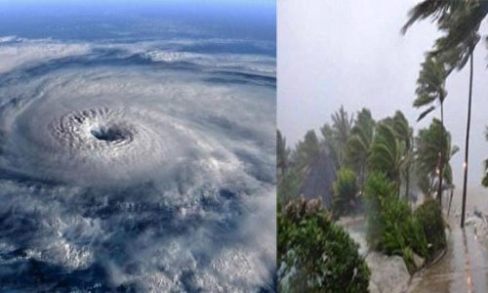
CLIMATE AND WEATHER 1 – Mid-latitude cyclones
Unit 2- Stages of development and related conditions
Geography grade 12
© j. rich 2020

Slide 2




approach
View the slides on the blog
This shows roughly how much time the section should take you
Th
HOW THIS COURSE WORKS
This is how we will work through and master the work in this course
Meet with teacher for discussion
Clicking on these will open a comment or further note
This is the number of the learning or assessment task in the blog
Do the learning & assessment tasks
5%
This unit is about 5% of the term work
Review feedback
INSERT LOGO HERE

Slide 3
REVIEW – WHAT YOU HAVE ALREADY LEARNED
1 minute
All cyclones are steep pressure gradients closed around a low pressure centre where the winds blowing from high to low pressure are deflected by Coriolis force in a clockwise direction in the southern hemisphere and anti-clockwise in the northern hemisphere.
Air converges around the low pressure centre at the surface, rises, and diverges in the upper air.
Mid-latitude cyclones have about six features that distinguish them from other types of cyclones
They occur where warm moist air from the tropics meets cold dry air from the polar regions (between latitudes 40-60)
They move further north in the southern winter affecting South Africa’s weather

Slide 4
Overview – what you will learn
After you have finished this unit you should be able to:
Name five stages in the development and life-cycle of mid-latitude cyclones.
Describe what happens during each stage
Explain how this affects the weather
Demonstrate the different stages using a diagram
Define and explain the terms: cyclogenesis stationary front
jet stream warm sector occluded front
Identify and interpret indications of mid-latitude cyclones on synoptic charts

Slide 5
CYCLOGENESIS – START AND BUILD-UP
The first two stages in the development of mid-latitude cyclones make up the process of cyclogenesis – the development and strengthening of cyclone conditions.
Barometric (air) pressure starts to drop

Slide 6
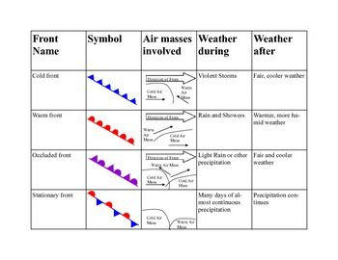
Symbols used on synoptic charts
Front type | Symbol on chart | Air masses involved | Weather during | Weather after
Cold front |  | Direction of system travel Cold air Warm air mass mass | Violent storms | Fair, cooler weather
Warm front |  | Direction of system travel Warm air Cold air mass mass | Rain and showers | Warmer, more humid weather
Occluded front |  | Direction of system travel Warm air mass Cold air Cold air mass mass | Light rain or other precipitation | Fair and cooler weather
Stationary front |  | Cold air Warm air Mass mass | Prolonged, almost continuous precipitation | Precipitation continues

Slide 7
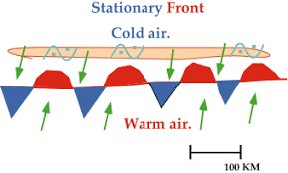
Stage 1: InITIAL STAGE
Warm, moist air from the tropics (as north-easterly winds (SH)) meets
Cold, dry polar air (as south westerly winds)
Neither is strong enough to dominate and a stationary front develops
https://lh3.googleusercontent.com/proxy/inbX2FDRg2lmqIzIKIuI8Zs2ZAWz2RaUO5psDv2Zf5QYoZ-ciwu0CEAvHbqBwUImkkv8zX0hyzcc7-Xyu1naQFJeSltRpA0fakGLiaqX0tqtIu75IDskdyov2cJaKQ

Slide 8
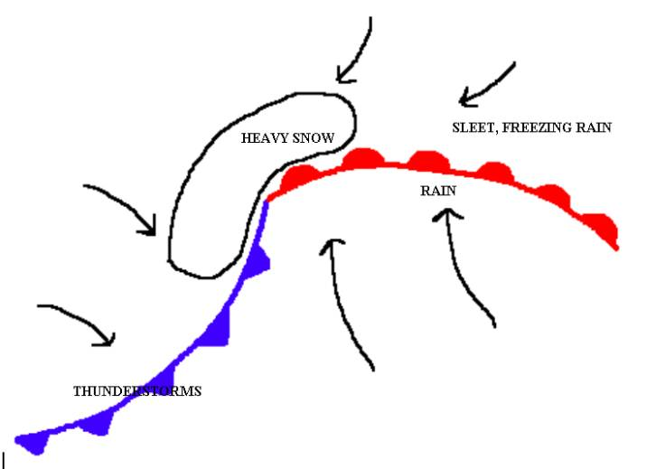
STAGE 2: DEVELOPIng stage
The stationery front is disrupted either by an obstacle (e.g. mountains) or jet streams
A kink or wave occurs allowing some warm air to penetrate the cold front

Slide 9
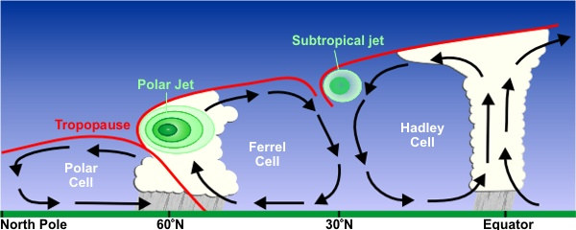
Jet streams
Jet streams are narrow bands of fast moving upper air wind
https://serc.carleton.edu/download/images/51532/polar_jet_stream.jpg

Slide 10
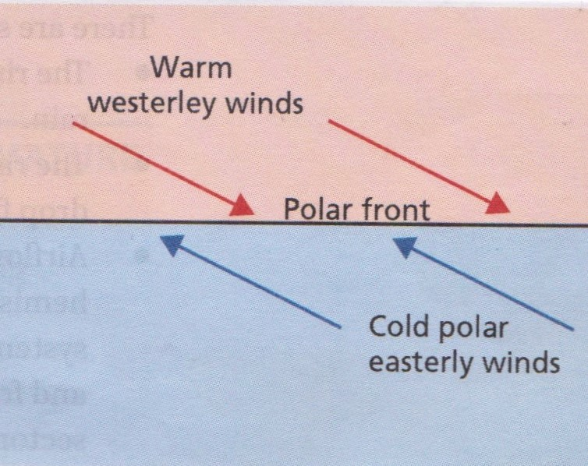
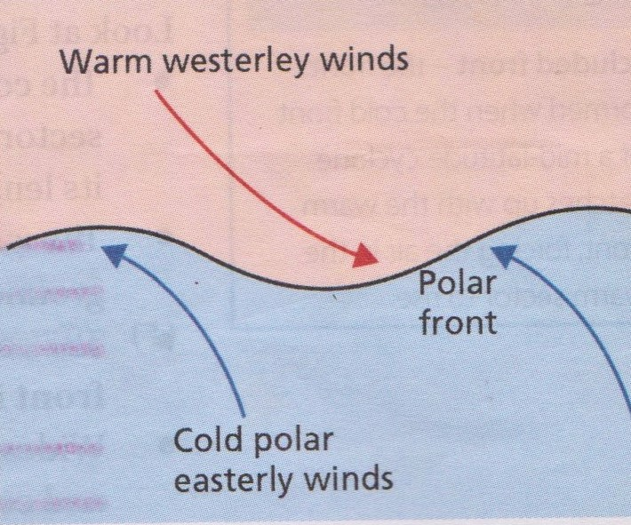
Summarizing the cyclogenesis stages
Stage 1: Initial stage with a stationary front
Stage 2: Developing stage when front is disrupted

Slide 11
Stage 3: mature stage
In the mature stage the low pressure cell at the centre is fully formed
The isobars are closed around it in a steep gradient
The cold front causes warm, moist air to rise rapidly and condense in heavy showers
There is a warm sector behind the warm front that start to rise over the cool air ahead and the resulting condensation produces moderate to light showers.
In the southern hemisphere the clouds and wind are circulating in a clockwise direction

Slide 12
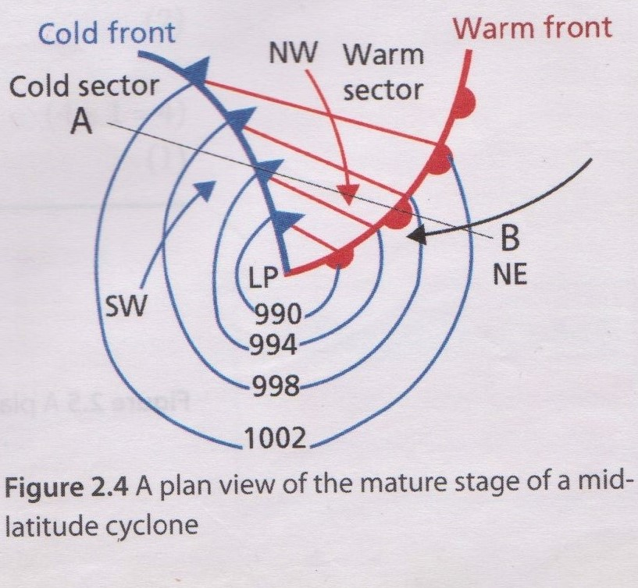
Stage 3: mature stage from above

Slide 13
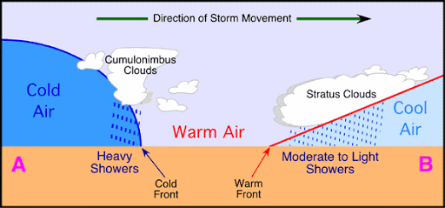
Stage 3: mature stage from the ground
https://lh3.googleusercontent.com/proxy/2YheLMQ_LI860TOCAPA9oS91nWR89wtokwATFsyLeeoZjEAAwHSp9tVbq3dhXB58Vwy_E2FuorqQ43lRbA_4E2DdtcvaHnSxcUOGI7DQCIWRIBBXXKJckfcJgrIuAT12CVY0VME15jRT

Slide 14
Stage 4: occluded stage
Eventually the warm air has mostly risen above the cold air and the cold front has caught up with the warm front.
There is only a very small warm sector
Rain and showers are widespread because the rising warm air condenses.

Slide 15
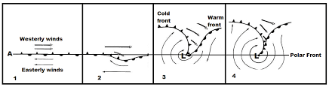
Comparing stages 1-4 from start to occlusion
https://encrypted-tbn0.gstatic.com/images?q=tbn:ANd9GcTK1RiAm__CtONGgw88TLloiz78OVwrwKSz-w&usqp=CAU
Note that the above diagram is for the Northern hemisphere. In the Southern hemisphere westerly winds are easterlies and easterly winds are westerlies

Slide 16
Stage 5: dissipated stage
There are no longer two distinctly warm or cold air masses so there are no longer warm or cold fronts present.
The isobars resume a regular pattern
There are only light gusts of cold air along the ground

Slide 17
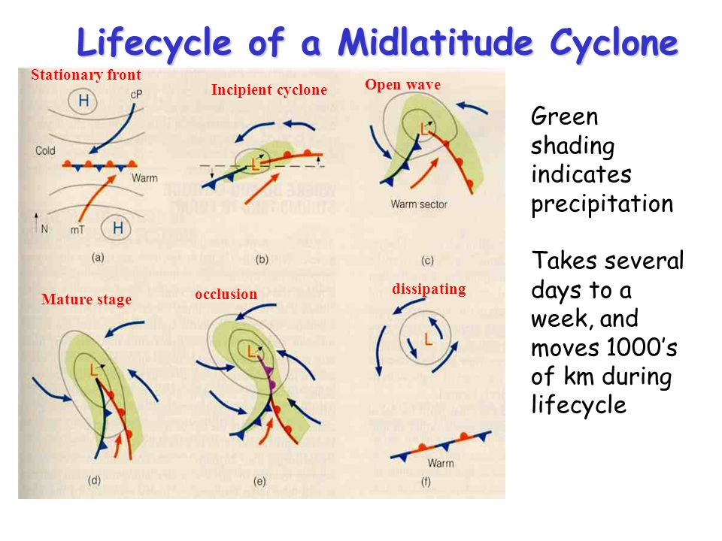
Summary: life cycle of a mid-latitude cyclone
https://slideplayer.com/slide/5029010/16/images/11/Lifecycle+of+a+Midlatitude+Cyclone.jpg

Slide 18
Checklist for self assessment
I can definitely: | Yes, confident | No, unsure
Name five stages in the development and life-cycle of mid-latitude cyclones. Describe what happens during each stage Explain how this affects the weather Demonstrate the different stages using a diagram Define and explain the terms: cyclogenesis stationary front jet stream warm sector occluded front Identify and interpret indications of mid-latitude cyclones on synoptic charts

