Slide 1

TRADE AND DEVELOPMENT – International trade
Geography grade 11
© j. rich 2020

Slide 2


Slide 3
Developed countries and advanced developing countries must open their markets for products from the developing world, and support in developing their export and import capacity.
- Anna Lindh

Slide 4
OVERVIEW
What is international trade?
How does it take place?
What role does trade play in development?
Which countries and commodities are mostly involved in world trade?

Slide 5


Slide 6
KEY TERMS AND CONCEPTS
TERM | DEFINITION
MARKET | The place or system where goods and commodities are bought and sold, nowadays it is mostly a virtual space and not a real physical place
COMMODITIES | Raw materials or manufactured goods that are bought and sold in large quantities
EXPORTS | Products a country sells outside its borders, they earn income for a country
IMPORTS | Products a country buys from other countries they cost a country money
TERMS OF TRADE | The relationship between the prices a country sells its exports for compared to the prices it pays for its imports
BALANCE OF PAYMENTS | How much money a country pays to the rest of the world compared to how much it receives from the rest of the world.
TRADING VOLUME | The total amount of material that has gone out of and come intoa country through trade
TRADING PARTNER | A country that regularly buys from or sells to another country

Slide 7
Comparing the value of imports and exports for selected countries in 2019
COUNTRY | IMPORTS $ US BILLION | EXPORTS $ US BILLION
USA | 2 611,4 | 1 665,3
CHINA | 2 134,9 | 2 494,2
JAPAN | 748,2 | 738,2
BRAZIL | 181,2 | 239,8
SOUTH AFRICA | 92,6 | 93,5
JORDAN | 20,3 | 7,7
ZAMBIA | 9,05 | 9,46
MAURITIUS | 1,98 | 5,66
MOZAMBIQUE | 6,78 | 5,19

Slide 8
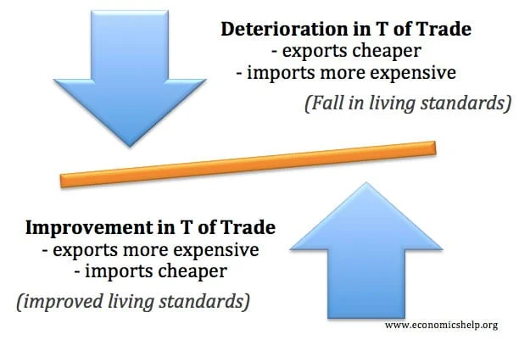

Slide 9
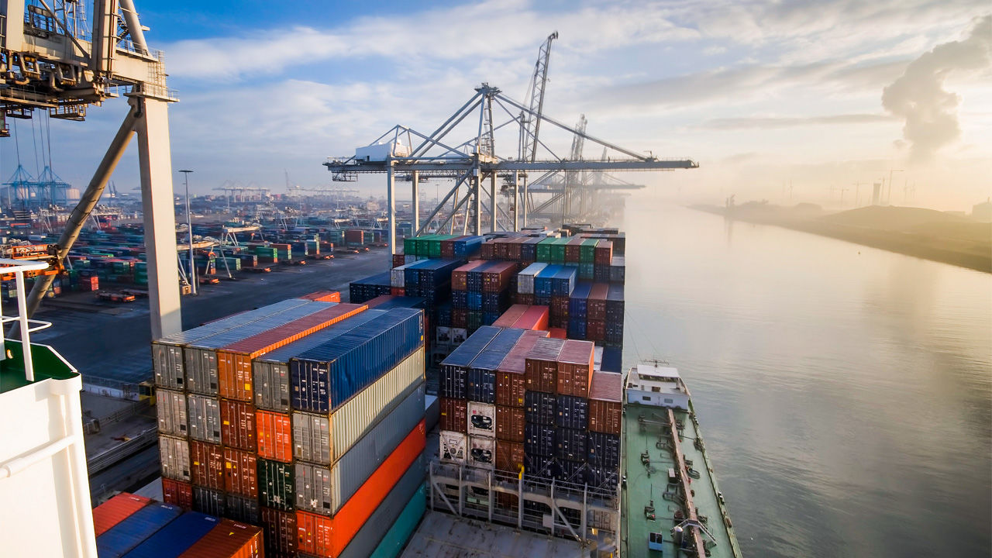

Slide 10
TOP COMMODITIES TRADED IN 2019 (Raw goods)
Crude oil
Coffee
Natural gas
Gold
Wheat
Cotton
Corn
Sugar
Silver
Copper

Slide 11
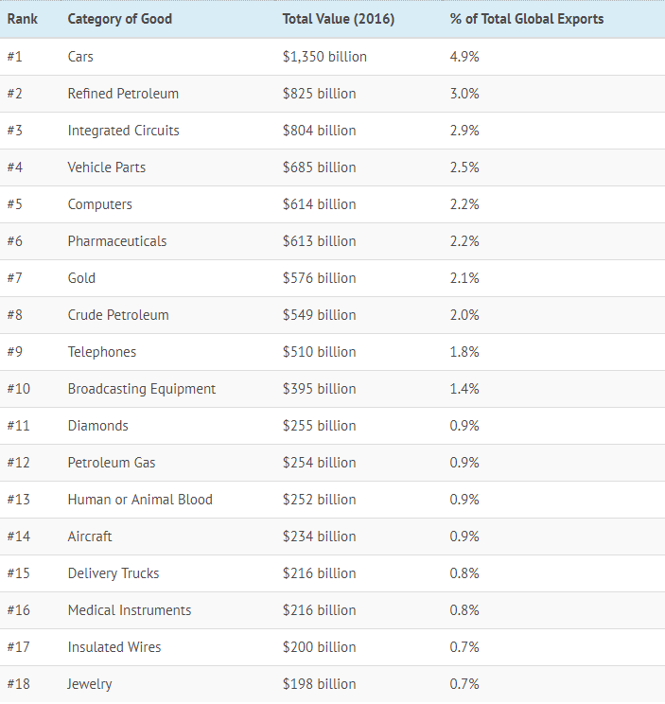
TOP PRODUCTS TRADED IN 2019

Slide 12
CALCULATIONS
Volume of trade = Value of exports + Value of imports
Balance of payments = Value of imports - Value of exports
Value of exports X 100 = T.O.T
Value of imports

Slide 13
SOUTH AFRICA’S TRADING PARTNERS
China: US$9.6 billion (10.7% of total South Africa exports)
Germany: $7.5 billion (8.3%)
United States: $6.3 billion (7%)
United Kingdom: $4.7 billion (5.2%)
Japan: $4.3 billion (4.8%)
India: $4.1 billion (4.6%)
Botswana: $4.1 billion (4.5%)
Mozambique: $3.7 billion (4.1%)
Namibia: $3.6 billion (4%)
Netherlands: $2.9 billion (3.2%)
Belgium: $2.7 billion (3%)
Zambia: $2.1 billion (2.3%)
Zimbabwe: $2 billion (2.2%)
United Arab Emirates: $1.6 billion (1.8%)
South Korea: $1.5 billion (1.7%)
Roughly two-thirds (67.3%) of South African exports in 2019 were delivered to the above 15 trade partners.

