Slide 1
INTRODUCING NATIONALISM
HISTORY GRADE 11
© J. RICH 2020

Slide 2
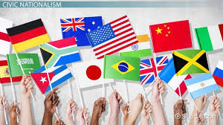
WHAT IS NATIONALISM?
Nationalism is an idea and movement that promotes the interests of a particular nation (as in a group of people) especially with the aim of gaining and maintaining the nation's sovereignty (self-governance) over its homeland. (Wikipedia)
A sense of national consciousness exalting one nation above all others and placing primary emphasis on promotion of its culture and interests as opposed to those of other nations or supranational groups. (Merriam-Webster Dictionary)

Slide 3
HOW IS A NATION STATE DIFFERENT TO OTHER COMMUNITIES
 | MONARCHY | RELIGIOUS COMMUNITY | NATION STATE
Who rules? | King or queen | Spiritual / religious leader | The government elected by the people or placed by a power group
How? | By divine right/ by birth | By the authority of the faith structure | Through democratic elections
Who are ruled? | Large bodies of people and regions | People living in the community | Citizens of the state
Who have rights? | Nobility have superior rights from the king; commoners have very few or no rights | Everyone has limited rights | All citizens enjoy a range of rights
How are people viewed? | Subjects who obey the monarch | Believers who obey God and the spiritual leaders | As citizens with rights

Slide 4
SOME CHARACTERISTICS OF NATIONS
Common language or culture
Shared origins
Independence from other countries
A common historical struggle
Agreed upon boundaries

Slide 5
HOW DID IT START
The American Revolution stressed citizenship and democracy (1776)
The French Revolution introduced a strong sense of nationalism alongside democratic freedom (brotherhood / fraternite)
Revolutionary wars in Europe in 1830 and 1848 were strongly linked to a sense of common nationalism and led to the unification of Germany and Italy
The Industrial Revolution led to increased urbanization, greater literacy and the rise of a skilled middle-class who were not nobility but who had wealth and power.
Colonialism encouraged national pride and the desire for dominance and also created a gap between colonial people and motherland population

Slide 6
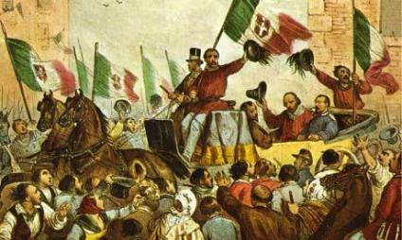

Slide 7
WHAT IS THE DIFFERENCE BETWEEN NATIONALISM AND PATRIOTISM?

Slide 8
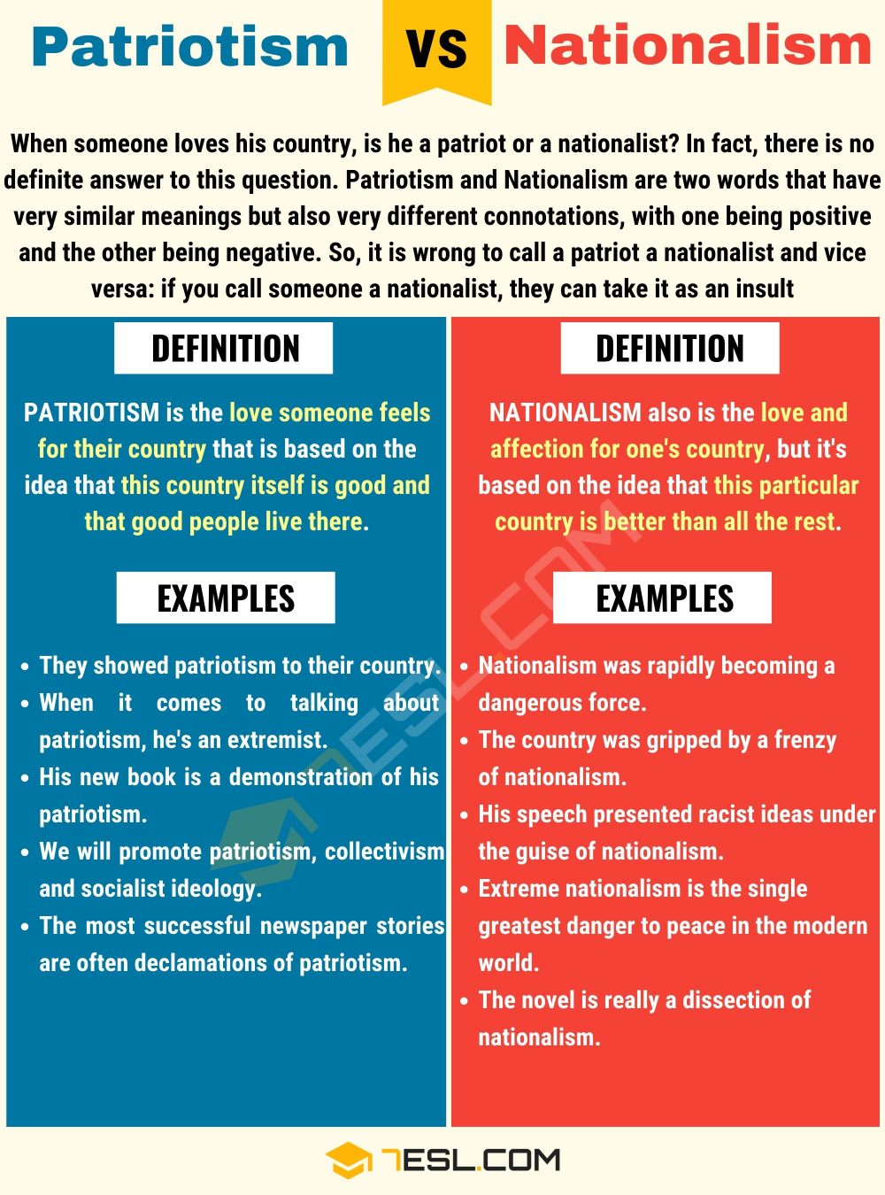

Slide 9
Nationalism as imagined community

