Slide 1
NATIONALISM IN SOUTH AFRICA (2) African Nationalism after WW2
HISTORY GRADE 11
© J. RICH 2020

Slide 2
OVERVIEW – What this unit is about
Unit 2 – The influence of World War II and the Atlantic Charter
Atlantic Charter
AB Xuma’s African claims
Returning soldiers

Slide 3
LEARNING OUTCOMES – Why are we studying this?
At the end of this module you will be able to:
Analyse and compare different expressions of an underlying philosophy or idea.
Evaluate the role and impact of events, individuals and organizations on a trend.
Identify and explain practical ways that nation building can happen today in South Africa

Slide 4
THE ATLANTIC CHARTER
WHAT? Agreement signed between USA and Great Britain
WHO? Pres. Franklin Roosevelt and Sir Winston Churchill
WHEN? August 1941
WHERE? Placentia Bay, Newfoundland
WHY? To outline plans for lasting peace after the end of WW2

Slide 5
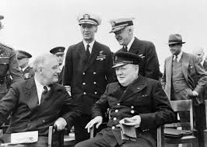

Slide 6
ATLANTIC CHARTER 8 POINTS
US and Britain would not seek any territorial or other gains from the war
No territorial changes against the wishes of the peoples concerned
Recognize the right of people to choose their own government and rule themselves
Free trade for all
International cooperation at the highest level
Freedom of sea travel
Freedom from fear and want
Global system of collective security and mutual disarmament

Slide 7
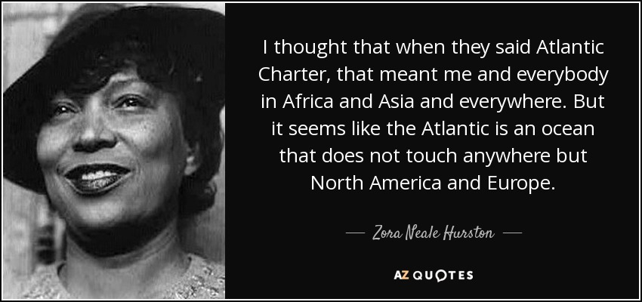

Slide 8
ATLANTIC CHARTER – SIGNIFICANCE FOR AFRICANS
Explain four ways in which the Atlantic Charter gave Africans a reason to expect and demand greater freedom.

Slide 9
A.B.XUMA’S AFRICAN CLAIMS
Xuma, as president of ANC, led a 28 member committee that drafted a document that gave an African perspective on the Atlantic Charter and included a Bill of Rights in Bloemfontein in December 1943.
It was intended that this document would be presented to world leaders to give Africans a say
https://www.sahistory.org.za/archive/african-claims-south-africa-dr-xuma-anc-conference-1943

Slide 10
Dr A.B. Xuma

Slide 11
INFLUENCE OF RETURNING SOLDIERS
“The soldiers of all races Europeans, Americans, Asiatics and Africans have won their claim and the claims of their peoples to the four freedoms by having taken part in this war which can be converted into a war for human freedom if the settlement at the Peace Table is based on human justice, fair play and equality for opportunity for all races, colours and classes.”
A.B.Xuma

Slide 12
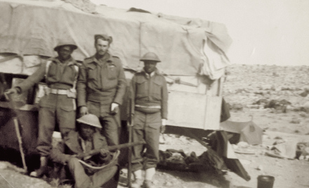
This photograph was taken by Warren Loader’s Grandfather Noel Edgar Fuller while serving with The Royal Durban Light Infantry (DLI) B Coy in North Africa during WW2. What makes this photo remarkable is the DLI L/Cpl is standing next to three armed members of the South African Native Military Corps (NMC).
So, visual proof that .303 Lee Enfields were issued to some members of the NMC.
https://samilhistory.com/2017/05/28/armed-sa-native-military-corps-in-ww2-this-corps-screams-out-for-a-definitive-work/

