Slide 1
THE END OF THE COLD WAR
GRADE 9 HISTORY – MR RICH

Slide 2
REVIEW
What was the cold war?
When did it start?
Who were the main opposing forces?
How did the Cold War affect Germany in particular?
What was the arms race about?
What were proxy wars?

Slide 3
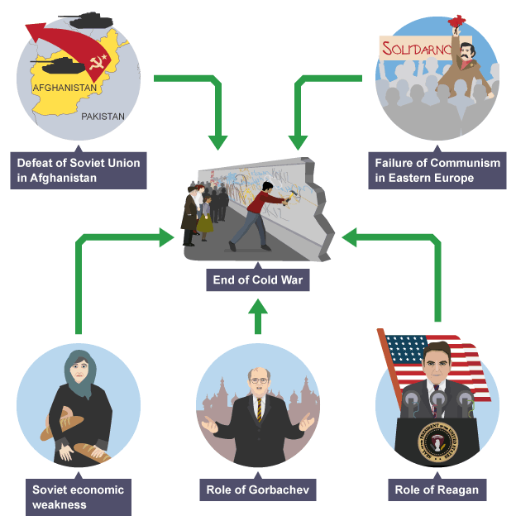
KEY FACTORS THAT BROUGHT AN END TO THE COLD WAR

Slide 4
THE WAR IN AFGHANISTAN
Russia defeated by Mujahideen who were aided by USA
Russia economically drained by the war

Slide 5
ECONOMIC PRESSURE
Food shortages and price increases in USSR and Eastern European countries
Corruption
Civil unrest and protests about costs

Slide 6
GORBACHEV’S POLICIES
Perestroika – Rebuilding the USSR economy – introduced many capitalist features
Glasnost – Greater civil liberties and freedoms to criticize; more contact with the west

Slide 7
REAGAN’S ROLE
Increased military pressure on USSR so that they could not keep up in the arms race
SDI , Missiles in UK, new weapons

Slide 8
RISING NATIONALISM IN EASTERN EUROPE
Poland – Solidarity – Lech Walesa – Collapse of Communist government
Hungary – open borders with Austria – collapse of Communism
Czech Republic had earlier rejected Communist government and been repressed now ousted Communists
Romania and Bulgaria
Break up of Yugoslavia
East Germany – fall of Berlin Wall 1989

Slide 9
RISING NATIONALISM INSIDE USSR
Break away of former soviet states into independent states and most chose democratic governments
Fall of Soviet Empire in 1991

Slide 10
IS THE COLD WAR OVER?
Soviet Union more moderate government
Eastern Europe and former Soviet states largely democratic and linking with West
Shift of focus to Arab oil states and ISIS
More trade links between east and west
Communists in Cuba and Vietnam more moderate and capitalistic
BUT
NATO still in place
Tension between USA and China
Middle East still a source of possible conflict
N. Korea still aggressively old style communist

