Slide 1

HISTORY AND ENGLISH
HOW TO WRITE A DISCURSIVE ESSAY

Slide 2
WHAT IS A DISCURSIVE ESSAY?
Factually accurate piece using evidence to present a balanced discussion around the given question.
Not completely neutral as the learner must present a consistent argument that addresses the question, but it is not an argumentative essay
A good discursive essay has detailed content and a logical, coherent argument and balances several points of view on the topic

Slide 3

PLANNING
After reading the question, brainstorm the ideas you have on the question
Develop your stance
Consider the evidence you will use to support your stance
Consider what other points of view you will review
Plan what will go into your introduction; body and conclusion

Slide 4
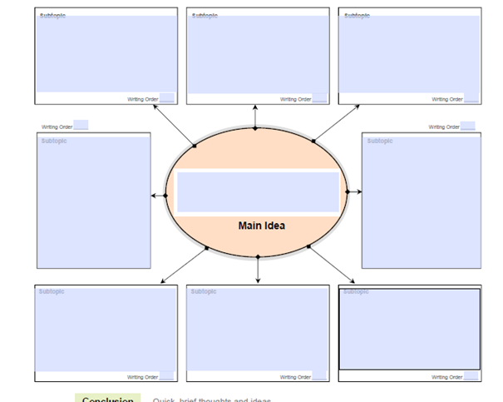

Slide 5

INTRODUCTION = THE TAKE OFF
The pilot informs passengers of their destination; route; expected time of arrival etc.
i.e. He prepares the passenger for the trip.
You provide context and show the direction of your argument.
i.e.You prepare the marker.

Slide 6
INTRODUCTION
Must clearly state the stance on the question
Background can be provided (in a couple of lines)
Indicate what areas your essay will cover
The introduction tells the marker what the essay is about, and what argument it will make

Slide 7
BODY = FLIGHT/ JOURNEY
Using navigational equipment (plan), the pilot steers the plane in the right direction. He comes in over the intercom to tell passengers the altitude, speed etc.
You use your plan to correctly structure your essay and to provide the evidence which supports your argument, or helps to answer the question.

Slide 8
BODY
Context should be integrated in the relevant paragraphs (not one isolated context paragraph)
Discuss main points
Provide evidence to support argument
Ensure you answer the question
Consider:
Does my paragraph contribute to answering the question?
Does my evidence support my argument?

Slide 9
CONCLUSION = THE LANDING
The pilot lands the plane and confirms the destination with the passengers.
You provide final statement of argument/ ensure that the question is answered.

Slide 10
CONCLUSION CONT.
A ‘wrap-up’ paragraph
Restates the argument made throughout the essay
Remember:
Do not introduce new information in the conclusion
The conclusion is not the place to make the argument

Slide 11
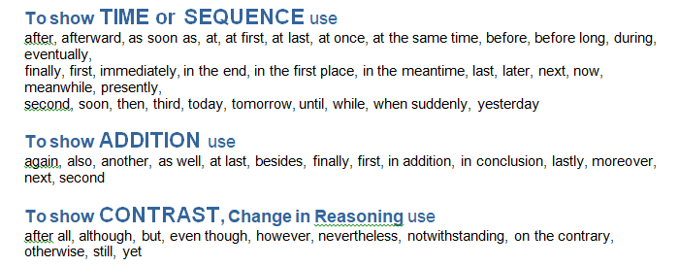
VOCABULARY

Slide 12
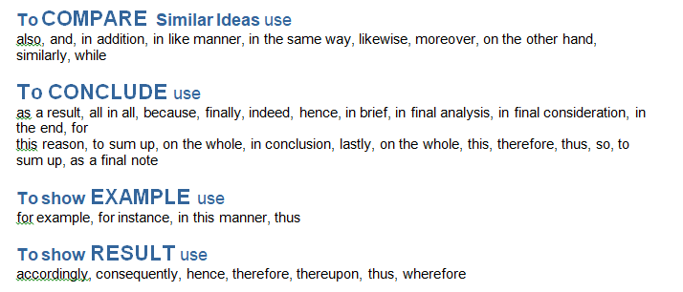
VOCABULARY CONT.

Slide 13
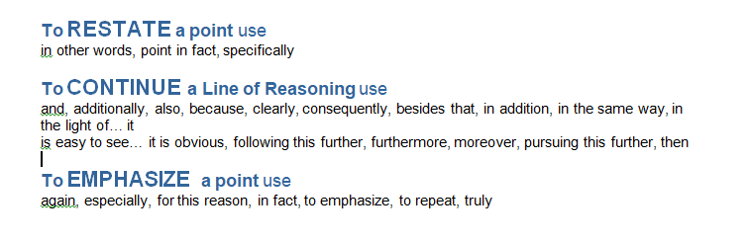
VOCABULARY CONT.

Slide 14
DO’s AND DON’Ts
DO’s
DON’Ts
Formal style
Write in past tense
Avoid emotive language
Provide evidence for points made
Use linking words and phrases
Use topic sentences
Don’t use generalisations or vague statements
Don’t use informal / colloquial language
Avoid first-person style
Don’t use point form
Don’t use headings

Slide 15
ESSAY CHECKLIST
Introduction:
Does the introduction give a direct answer to the question?
Does the introduction give an idea of what content will be covered in the essay?
Body:
Is there a topic sentence?
Is there more than one idea in the paragraph?
Does the paragraph focus on the question?
Is there evidence to support the stance adopted?
Is the content relevant?
Is the flow of the paragraphs logical?

Slide 16
ESSAY CHECKLIST CONT.
Conclusion:
Is it focused on the question?
Does it summarise the argument?

