Slide 1
Geomorphology of rivers MODULE 1 – drainage systems in south africa
GR 12 GEOGRAPHY– MR RICH – 8 MAY 2020

Slide 2
HOW TO FIND YOUR WAY AROUND THIS MODULE
3 MINUTES
When you have completed this page you will understand how to find things and how to work through the module.
This module is set out in a number of slides or pages like this one. Each page deals with a separate topic. And the heading of the page will tell you what it is about. Under the heading is a short summary of what you will learn from that page. Click on the DOWN arrow to move to the next page or the UP arrow to go to the previous page..
Some pages will refer you to other sites such as the Wiki using a link like this: http://www.lifebridgeschool.co.za/wiki/index.php?title=Geomorphology_-_Rivers
or other sites on the internet with a link like this: https://www.tulane.edu/~sanelson/eens1110/streams.htm
Place your cursor over the link and left-click to open the page.
In the top right hand corner is a box with an estimate of time it will take you to complete that page. This just an estimate and it may take you less or more time, but it is a helpful guide.
From time to time you will be required to complete an ACTIVITY or a TASK and detailed instructions will be given about how to do so.
Sometimes a new or important word or concept will have a comment box like this . By left –clicking on the box, you will open a comment to the right which will explain the word or concept in more detail or give you more information.
Every page is numbered as below and the next page will tell you on which page you can find a particular topic.

Slide 3
HOW THIS MODULE IS SET OUT
2 minutes
When you have completed this page you will understand how this module is organized and where to find different topics.
The module is set out as follows:
COURSE INFORMATION TOPICS | PAGE | LEARNING OUTCOMES | PAGE
How to find your way around the module | 2 | LO 1 Explain key concepts (Activities 5 & 6) | 9
How the module is set out | 3 | LO 2 Classify and compare types of rivers (Activity 7) | 10
How to get support and stay in contact (Activity 1) | 4 | LO 3 Explain cause and nature of different drainage patterns (Activity 8) | 11
Plagiarism, academic integrity, and citation (Activity 2) | 5 | LO 4 Calculate drainage density and explain what affects it (Activity 9) | 12
Quality standards and expectations (Activity 3) | 6 | LO 5 Use topographic maps to identify stream order and density (Activity 10) | 13
Purpose and importance of the module (Activity 4) | 7 | LO 6 Distinguish types of stream flow and their implications (Activity 11) | 14
Assessment | 8 | Module summary and reflection

Slide 4
HOW TO GET SUPPORT AND STAY IN CONTACT
5 MINUTES
When you have completed this page you will understand the importance of keeping in contact with your teacher and fellow students and how and when you can and must do so.
Working alone in isolation at home poses real challenges as far as discipline and motivation are concerned. It is also a problem if you encounter difficulties or need clarification about some aspect of the work. It is easy to “get stuck” and just give up. Another difficulty with online learning is that you easily miss out on the stimulation and rich exchange of ideas and information that happens through group work or classroom discussions. How do we get around these obstacles?
1. You may contact your teacher at any time but the best times are 0930-1230 and 1430-1600 every day on WhatsApp or call at 0720452674 or on Skype at johanrich1.
2. You must check in on WhatsApp every Monday morning between 1000 and 1030 with a message, voice note or call to say how you are managing and to ask any questions.
3. Please make as much use as possible of the comment box at the end of the blog to post questions, suggestions, comments and other information and do respond to each others comments. Part of your assessment will be a participation mark based on the requirement to post at least two comments per week.
4. You are encouraged to share ideas and information with each other especially around the tasks and help each other to complete tasks and you may use any way to do so that works for you.
ACTIVITY 1 (a) Post a comment in the comment box at the bottom of the blog stating one important reason why you think it is valuable to study rivers and their effect on the landscape and pose one question about rivers that you would like to find the answer to. Do it now. Remember to add your name when you comment.
(b) Send me a WhatsApp note saying one thing you like in or about rivers.. Do it now.

Slide 5
PLAGIARISM, ACADEMIC INTEGRITY, AND CITATION
15 MINUTES
When you have completed this page you will be able to explain the difference between in-text and bibliographic citation and why it is important to cite references to avoid plagiarism.
Plagiarism is completely unacceptable and can have serious consequences. You are expected to do your own work and to give due credit when you do make use of other people’s ideas, inputs or content, even if you have rephrased or adapted it into your own words or format. You may even be asked to submit a plagiarism report with some assignments. You can use this site to do so: https://plagiarismdetector.net/
Citation. When a source is used in an assignment it must be followed immediately by (Author, Date) and in the case of a web site (Website title and date accessed). At the end of the assignment a list of references or bibliography must appear that gives full details of each reference in alphabetical order. Get more information here: http://libraryguides.vu.edu.au/harvard/getting-started-with-harvard-referencing.
ACTIVITY 2
Post in the comments box at the end of the blog a citation (bibliographical details) of any source you can find dealing with the topic “Drainage systems in South Africa”. (Remember to add your name when you make a comment.)

Slide 6
QUALITY STANDARDS AND EXPECTATIONS
8MINUTES
After completing this page you will be able to explain steps you can take to ensure that your work is of an excellent standard.
Although you are not in the classroom and working online is a different experience to conventional school work, you are still expected to aim for excellence and submit the best possible work that you are capable of doing.
Here are some steps you can take to ensure quality work:
Allow yourself enough time to avoid doing rushed work.
Break up your longer assignments in to smaller parts and plan when you will do each part.
Use a spelling and grammar checker and a dictionary
Check your completed assignment against the question or task description to ensure that you have met the requirements
Ask a parent, family member, classmate or friend to check your assignment before you submit it.
Always check that you have acknowledged every reference properly.
ACTIVITY 3. In the comments box at the end of the blog post an entry explaining one additional step you are going to take to ensure that your work is excellent.

Slide 7
PURPOSE AND IMPORTANCE OF THE MODULE
45 MINUTES
When you complete this page you will understand why the subject of this module is worth studying and be able to evaluate five possible reasons for studying drainage systems.
Geomorphology is concerned with the forces and processes that have produced the features we find on the surface of the earth and how humans are influenced by and use the landscape around them. One of the powerful forces that shapes the surface of the earth is water, especially moving water such as rivers. If we can understand how rivers operate and act we are in a better position to harness their potential for good and to avoid harming or being harmed by them. However, not all rivers are the same and rivers are more than just the water you see at a particular point. Each river is actually a part of a complex system and it changes at various points along the river.
ACTIVITY 4 Reasons for the importance of studying drainage systems
Study the section in the Wiki on drainage system entitled “Why studying drainage systems may be important. http://www.lifebridgeschool.co.za/wiki/index.php?title=Geomorphology_-_Rivers#Drainage_systems.
List in rank order from most to least important five reasons why it is worth studying and understanding river drainage systems. Use your own words as far as possible to state the reasons. Post your response in the comment box at the end of this blog for other students to see and comment on and feel free to engage them and comment on their posts.

Slide 8
ASSESSMENT
2 MINUTES
After you have finished this page you will understand how your learning will be assessed, what criteria and standards will be used and how the assessment results will be used as part of your overall learning
You will receive an assessment of participation and engagement based on your completion of the activities and your posting of blog comments. Each activity will be assessed as 0- not done 1– attempted but incomplete, misunderstood or flawed or 2- adequately done. For example, if you were asked to post two lists of 4 -5 items each and you only post one list or each list is less than 4 items then you will score a 1, but if you post two lists of 4-5 items each you will score 2.
At the end of the entire section on rivers which includes two more modules you will write a formal test that will draw on your knowledge and understanding of the work covered in this module.
When you have completed the entire section on rivers you will have a problem solving task involving a case study. This will require you to do some deeper thinking and problem-solving and you will have to prepare a report setting out your suggestions. In that task you will be assessed on your application of knowledge from this and other modules, your ability to analyse the component parts of the problem, your ability to formulate a clear proposed solution and your ability to evaluate and select from several options.
The results of this assessment will be used to determine if you are ready to move onto the next module. They will also be used as part of your term mark but not your portfolio.

Slide 9
LO 1 EXPLAIN KEY CONCEPTS
2 HOURS 30 MINUTES
LEARNING OUTCOME 1: You will be able to identify and define key concepts related to drainage systems.
ACTIIVTY 5
Read the notes and view the video provided in the Wiki section B and C http://www.lifebridgeschool.co.za/wiki/index.php?title=Geomorphology_-_Rivers
Watch these videos on concept mapping /www.youtube.com/watch?v=8XGQGhli0I0 and https://www.youtube.com/watch?v=C98YgAzpleQ
Create your own concept map to summarize the information in part B of the WIki
ACTIVITY 6
In the table below match the terms in the left-hand column with the definitions in the right-hand column
60 MINUTES
20 MINUTES
60 MINUTES
10 MINUTES
TERM | DEFINITION
1.Water table | a. Network of all tributaries that join together to form one main river that flows to the sea
2. Source | b. Soil and rock underground above the water table that has open air spaces
3. Drainage basin | c. Smaller river joining another river
4. River system | d. The end of the river where it flows into the sea
5. Aerated zone | e. Land area that feeds water into a river system
6. Tributary | f. Point where two rivers meet
7. Saturated zone | g. Upper limit of the saturated zone
8. Confluence | h. High ground separating drainage basins
9. River mouth | i. River gaining water from the ground water because the river bed is deeper than the water table
10 Watershed | j. The start of a river
 | k. That part of the crust that is below the water table. All air spaces are filled with water.

Slide 10
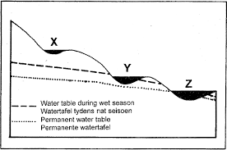
LO 2 CLASSIFY AND COMPARE TYPES OF RIVERS
When you have completed this page you will be able to classify rivers into one of four categories and you will be able to compare the important features of each type.
In the diagram below there are cross-sections of three rivers in relation to the underlying water tables
ACTIVITY 7
Which of rivers X, Y and Z are fed by groundwater and when? How does this affect their appearance and flow? What do we call each type of river?
If a fourth river A had a similar profile to X but it had several tributaries in high-lying areas that received high rainfall and the tributaries had profiles like Z would this river appear more like X or Z? What is such a river type called?
What type of river is the Gonubie river? [Post your responses to this activity] in the comments box of the blog and see if you agree with each other
20 MINUTES

Slide 11
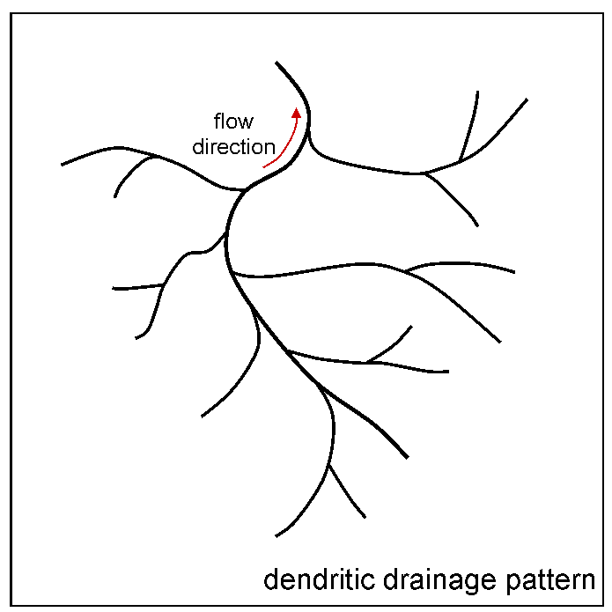
LO 3 EXPLAIN CAUSE AND NATURE OF DIFFERENT DRAINAGE PATTERNS
30 MINUTES
When you have finished this page you will be able to distinguish between different drainage patterns and explain their causes.
ACTIVITY 8
Study the relevant section in the Wiki and on the video and then make a table for your study purposes that summarises the seven drainage patterns . The first row of the table is given below as an example:
DRAINAGE PATTERN | SKETCH THE PATTERN AS SEEN ON A MAP | CHARACTERISTIC FEATURES | CAUSE
1. Dendritic |  | Tributary confluences are acute angled | Any rock type; uniform slope and uniform resistance to erosion

Slide 12
LO 4 DRAINAGE DENSITY
20 MINUTES
When you have completed this page you will be able to explain the concept of drainage density; to calculate drainage density and to explain what factors affect it.
Drainage density is a measure of how quickly and efficiently water is drained or removed away form an area by flowing into streams and away towards the river mouth.
ACTIVITY 9
Study the relevant section in the wiki then respond to the case below and post your responses in the comments box at the end of the blog. Look at other students’ responses and give them feedback.
A farmer has a large farm measuring 6,4 sq. km. but he is concerned that he may not always have enough water for his crops. He decides first to work out how quickly water drains off his property. The farm has 8 different streams crossing it and their total length is 12, 8 km. Previously most of the farm was used for growing pineapples, but he is keen to use it as pasture for cattle and to grow a mixture of lucerne, maize and oats.
What is the drainage density of his farm?
Is there anything he can do to retain more underground water and reduce the amount that is drained away?

Slide 13
LO 5 USE TOPOGRAPHIC MAPS TO IDENTIFY STREAM ORDER AND DENSITY
15 MINUTES
When you have completed this page you will be able to explain what is meant by stream order and be able to tell from a topographic map in what direction a stream is flowing, the order of streams and the relative density of the drainage in an area.
ACTIVITY 10
Study the following video (https://www.youtube.com/watch?v=Mvg_mbI0DCk) to understand how to classify the order of streams.
Study the relevant section of the wiki for more insight into stream order.http://www.lifebridgeschool.co.za/wiki/index.php?title=Geomorphology_-_Rivers
Remember that you must always work from the source towards the mouth when determining stream order. By observing two pieces of information on a topographical map it is easy to determine in which direction a stream is flowing: the patterns of contours – the apex or sharp points of V-shaped contours through which a stream flows always point towards the high ground, and if you check the spot heights the stream will move from the greater heights towards the lower heights.

Slide 14
LO 6 RIVER DISCHARGE OR FLOW
15 MINUTES
When you have completed the activities on this page you will be able to explain the difference between laminar, turbulent and helical flow; explain the reason for the differences; and state what the effects of the flow are.
Carefully review the relevant section of the wiki http://www.lifebridgeschool.co.za/wiki/index.php?title=Geomorphology_-_Rivers.
ACTIVITY 11
Decide what sort of stream flow is present at each of the following points and give reasons for your conclusion. Post your response as a comment at the end of the blog and give your fellow students feedback:
Karen: Zambesi rapids just below the Kariba dam. https://www.pureafricaexperiences.com/wp-content/uploads/2017/01/guide-rafting-rapids-zambezi-river.jpg
Takudzwa: Nahoon river beneath the Batting Bridge in Beacon Bay
Takunda: Nahoon river at Blue Bend below the hotel

Slide 15
MODULE SUMMARY AND REFLECTION
20 MINUTES
This page will allow you to reflect on what you have learned from this module and it will give you an opportunity to share feedback on the module.
ACTIVITY 12
Post a comment (with your name) at the end of the blog commenting on the following:
What are three new things you have learned by doing this module?
What did you enjoy or what worked well for you in the module?
What would you suggest be improved in the module?
Was the time allocation suggested too little time, too much or mostly just right?

